Slide 1
Understanding Religious Moderation in the Digital World
Kamaruzzaman Bustamam ahmad

Slide 2
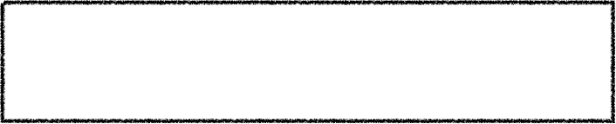

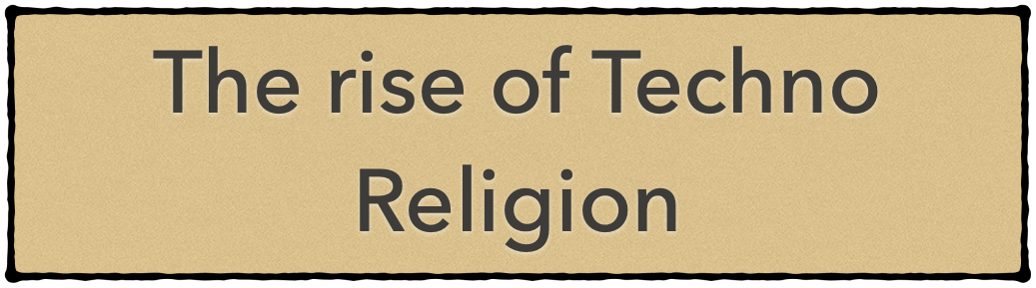





What to Cover in this presentation?
Trans-Humanism
Robotics
Cyborgs
AI
From Animal to Digital World
Production of Knowledge
Human Experience

Slide 3


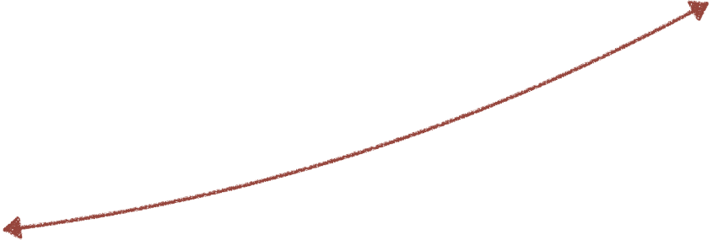

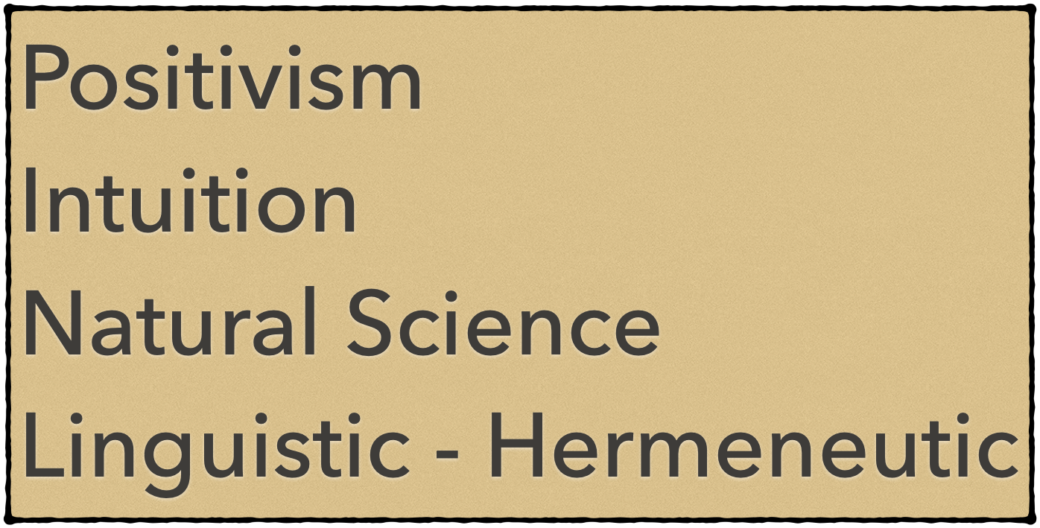


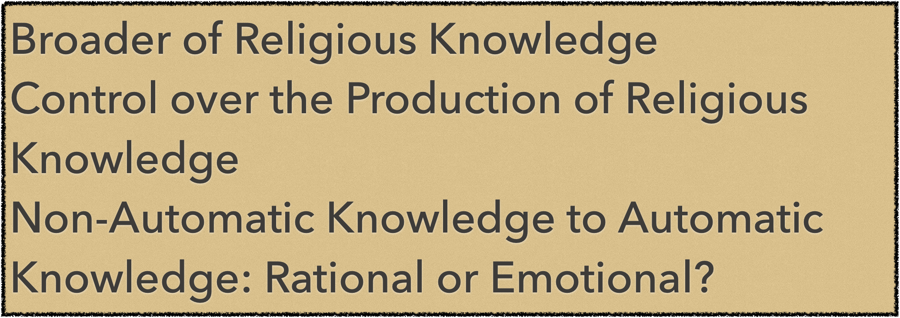
From Non-Internet Knowledge
to Internet Knowledge
Automation of Production of Religious Knowledge

Slide 4




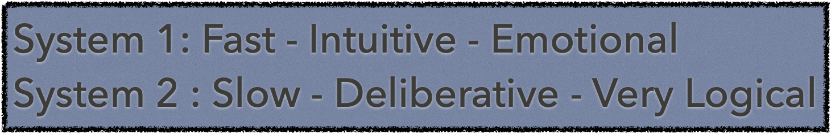

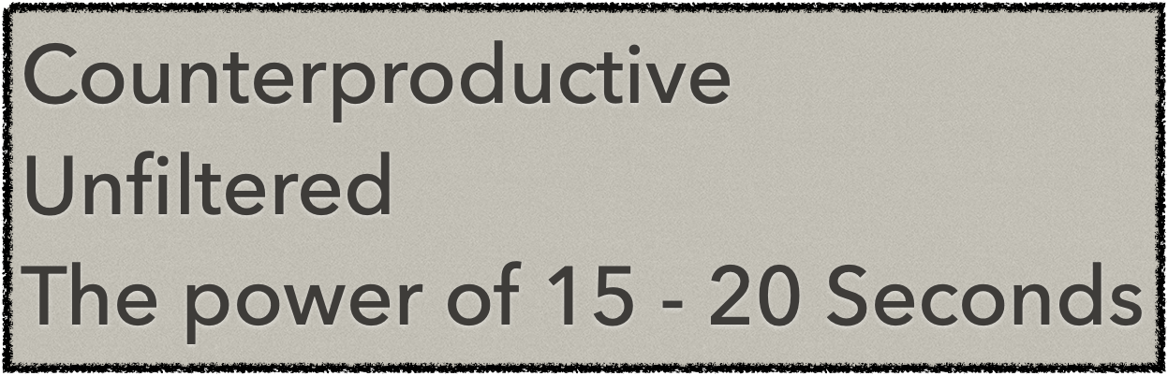
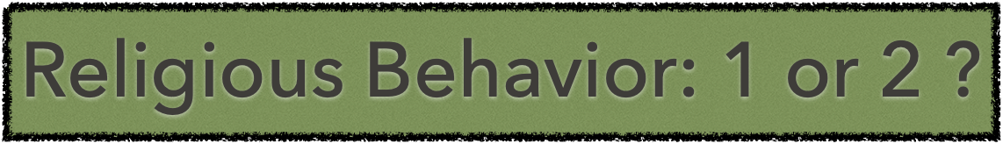

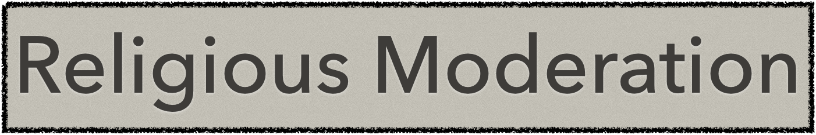


Slide 5



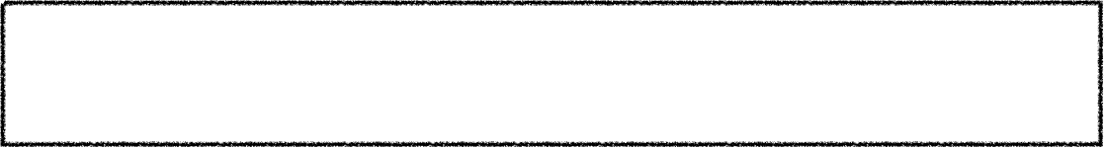
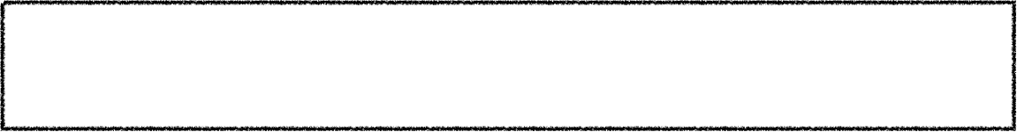

Un-artificially constructed ?
Optional Possibilities
Mis-used for un-religious purposes?
Virtual religious behavior based?
Religious Moderation in Cyberspace
From not friendship for the sake of religion to friendship not for the sake of religion?
From organizational to individual religious tolerance?
Toward virtual religious moderation?

Slide 6
Thank You

