Slide 1
The Dynamics of Muslim Society in Indonesia After the Election
Kamaruzzaman Bustamam-Ahmad

Slide 2
Aim:
To understand dynamics of Muslim society in Indonesia by looking at several religious issues after the current national election.

Slide 3
Changing of Order in Indonesia
President
Bussinesman
Military
Golkar
Bureaucrat
President
Military
Political Party
Media
Bussinessman
New Order
Orde Reformasi

Slide 4
Roots of Values in Indonesia?
Javanism
Chatolicism
Americanism
Islamism

Slide 5
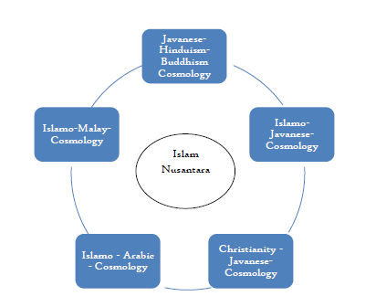

Slide 6
New Trends in Socio-Religio-Cultural
Index and key word base mind
Internet based religious knowledge.
From cultural-reproduction-religious-knowledge To popular – reproduction – religious – knowledge.
Safe Zone in Religious Understanding.”
Religious as complimentary knowledge, not as ultimate religious knowledge.
Directive profiling based information.
Virtual religious addictive knowledge
Reproduction of enemy among internal community.
AI in Socio-Cultural and Religious Issues.

Slide 7
Clifford Geertz’s Thesis (?)
Abangan
Santri
Priyayi
Jokowi
NU
PDI-P, Golkar, PPP, Nasdem
Ultra-Nationalist Group
Prabowo
Muslim Group (212)
Gerindra
PKS
SBY
Demokrat
AHY for 2024

Slide 8
3 Ks in the Election
Religious Issues
Komunis (Communist)
Khilafah
Kudeta (Coup)

Slide 9
Psy War in Social Media
Hate Speech (Post-Truth)
The Role of National Police
Former Chief Kopassus arrested
Techno-Religion and Dataism (Yuval?)

Slide 10
Terima kasih!

