Slide 1
From Teungku to Ustaz:
A Portrait of Islamic Education in Aceh, Indonesia
Kamaruzzaman Bustamam-Ahmad
IAIN Ar-Raniry, Banda Aceh

Slide 2
The Hierarchy of Ulama in Aceh
Abu Chik/Tgk. Chiek
Associated with the place and as “father” of Society. (Abu Tanoh Abe, Abu Tanoh Mierah, Abu Panten, etc.)
However, the term of “Abu” used by GAM member as “local panglima.”
Facts: Abu Beureu-eh, Tgk. Chik Di Tiro, Tgk. Hasan di Tiro, not Tgk. Chik Hasan di Tiro or Abu Chik Hasan di Tiro.
Tgk. Muzakir Manaf, Tgk. Abdullah Syafi’i.

Slide 3
Cont.
Abu Chik also as the Syaikh.
Abu Chik develops the curricullum for Dayah.

Slide 4
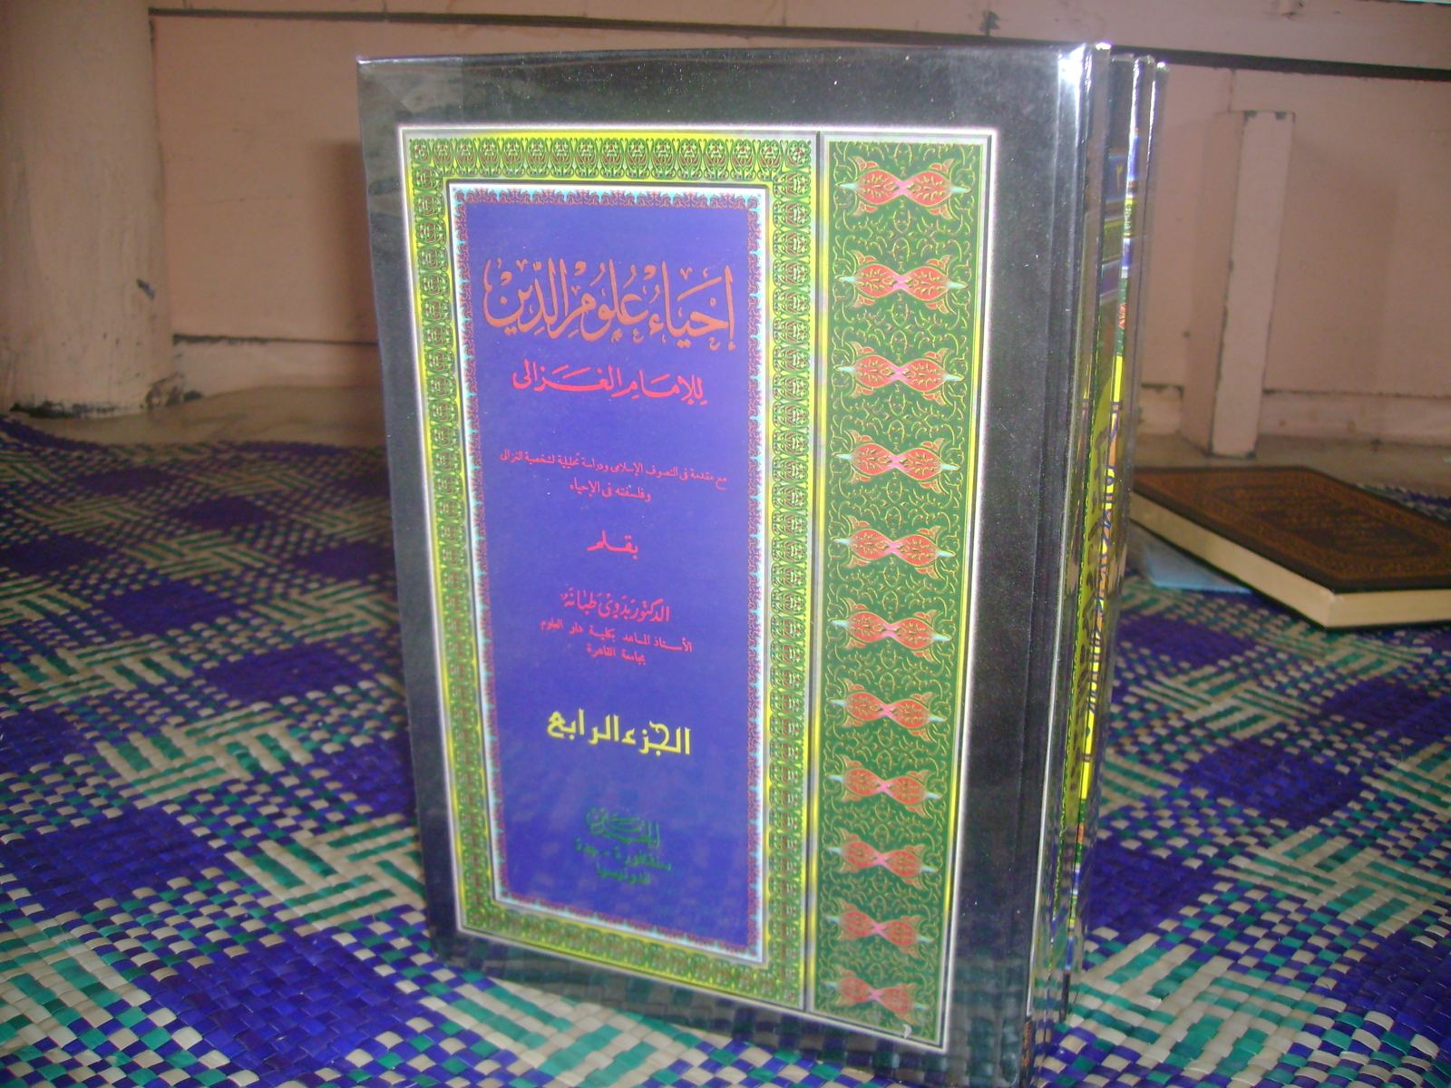
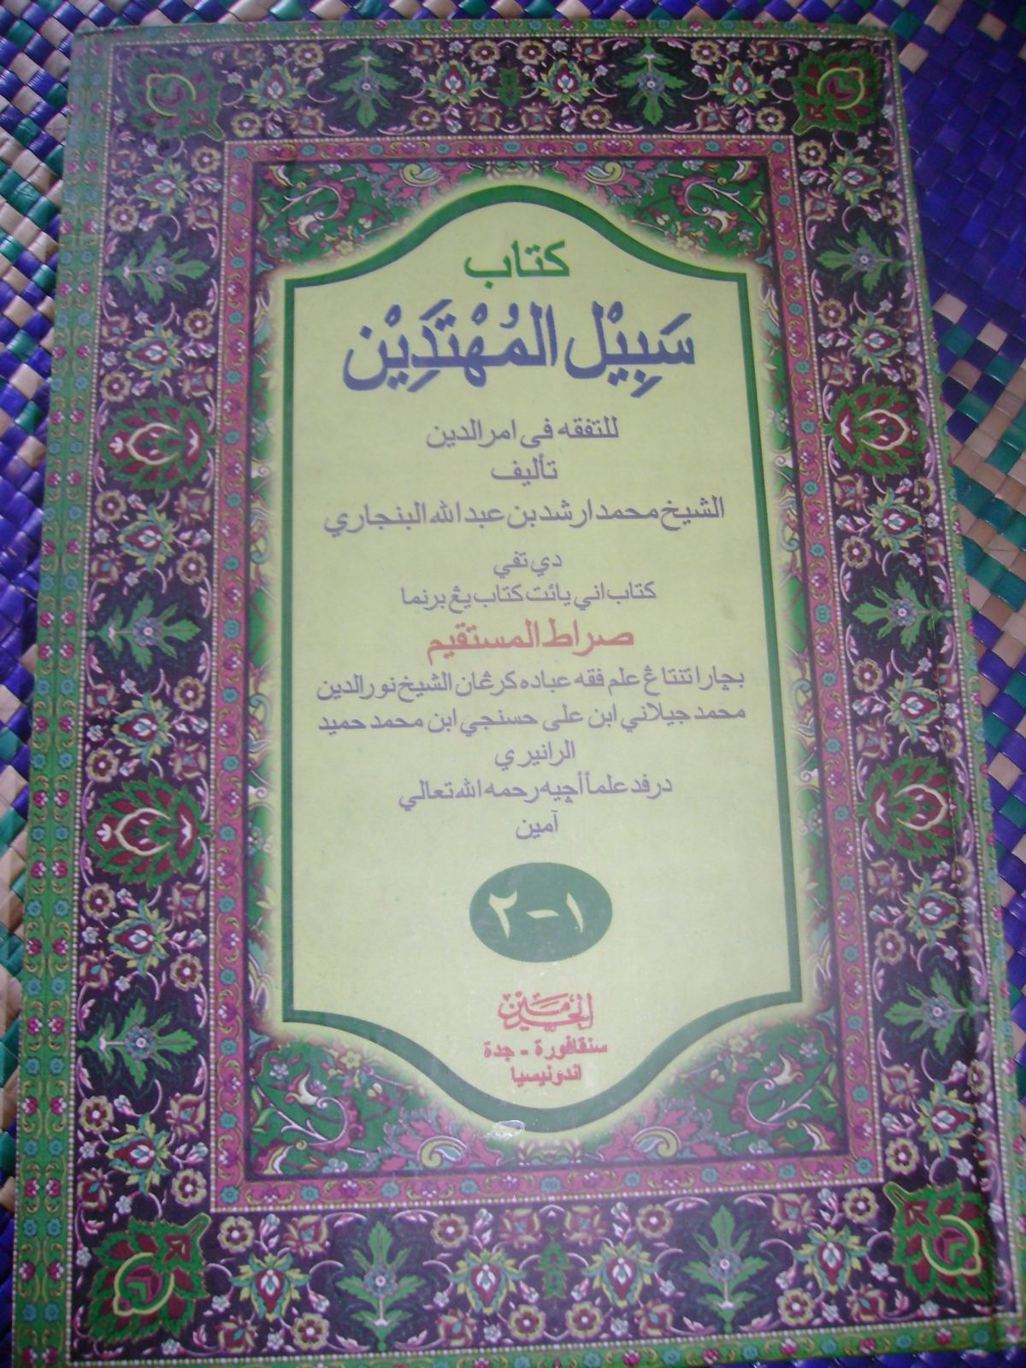
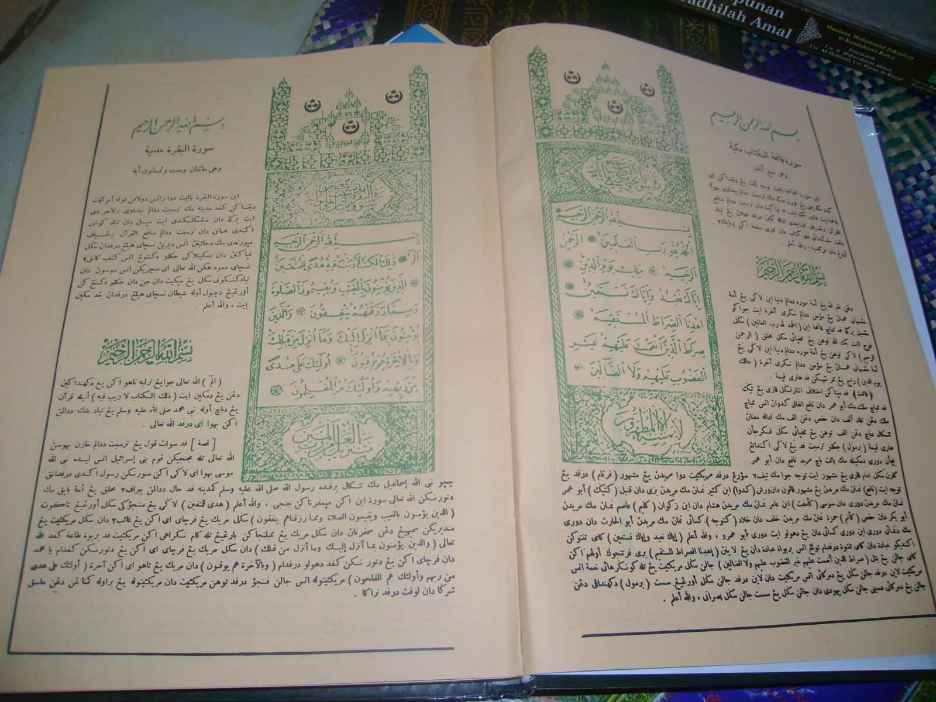

Slide 5
Tgk. Bale
Acts as teacher and assistant for the Tgk. Chik/ Abu Chik.
Tasks: Imam,Khenduri, khutbah. Representing Tgk. Chik.
As part of Dayah network, because (1) some married with daughter or family of Tgk. Chik; (2) opened their own dayah after graduated from dayah.
Some networks: Dayah Mudi, Dayah Mesjid Raya, Labuhan Haji’s network

Slide 6
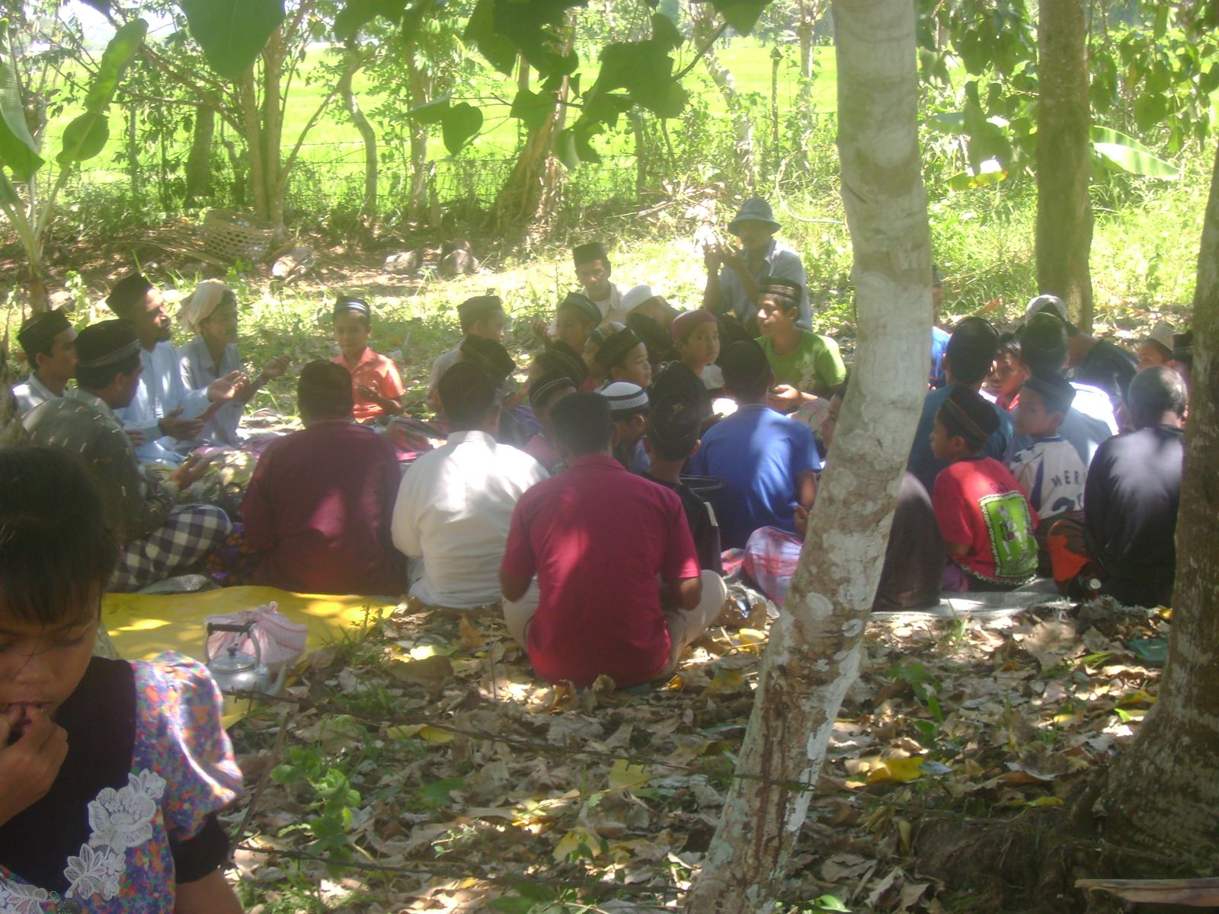
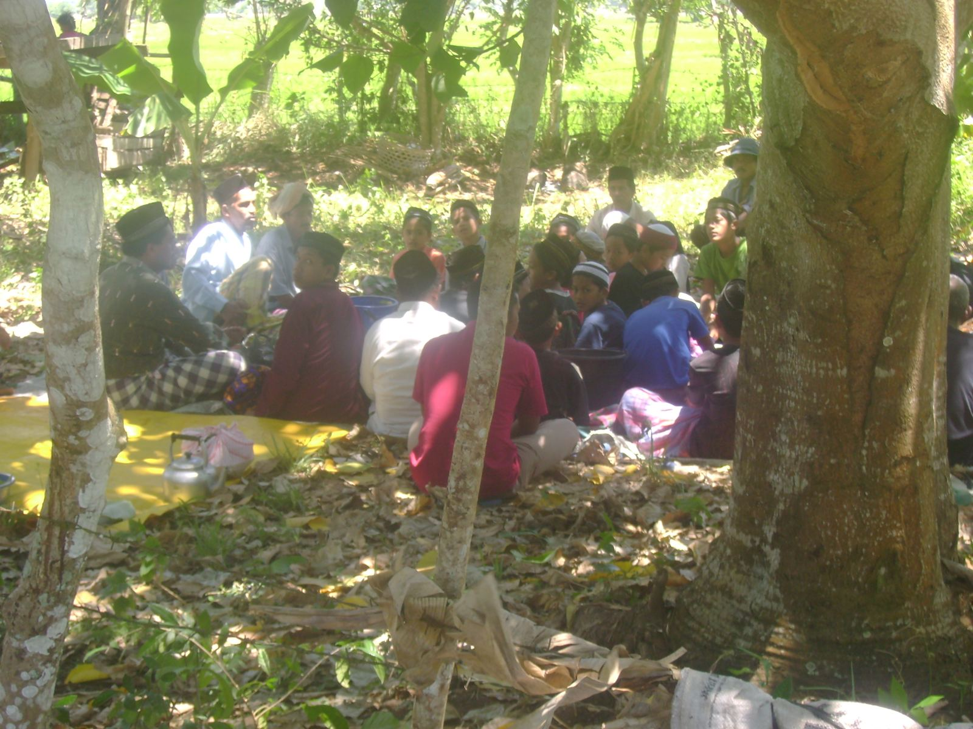
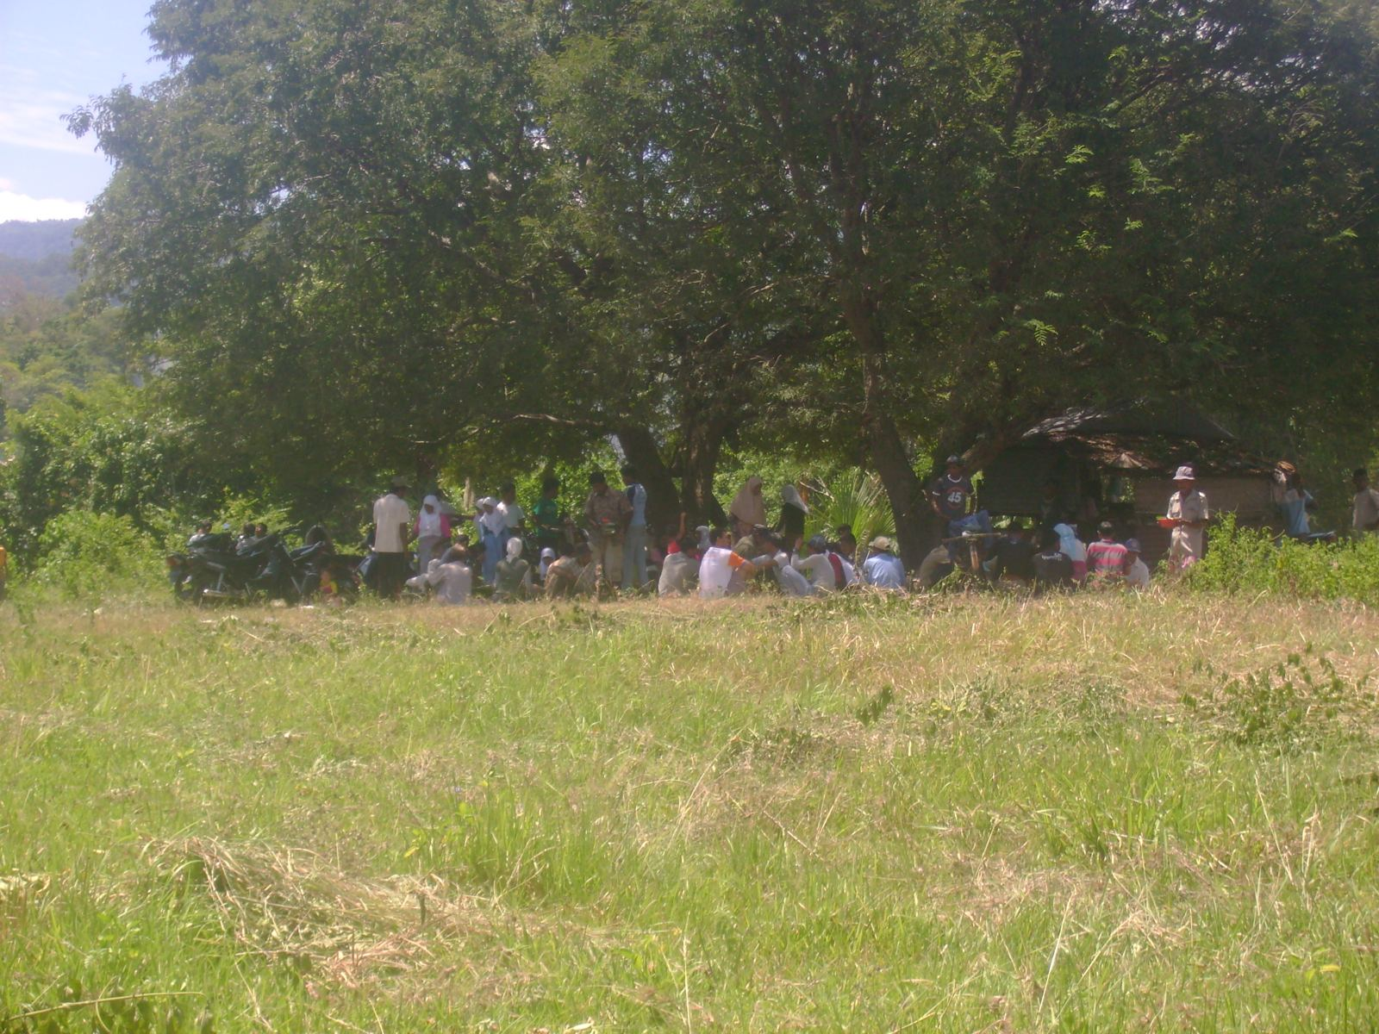

Slide 7
Teungku Rangkang
Assistant for Tgk. Bale
Some Teungku Rangkang will achieve the position of Teungku Bale due to their progress and loyalty to the system.

Slide 8
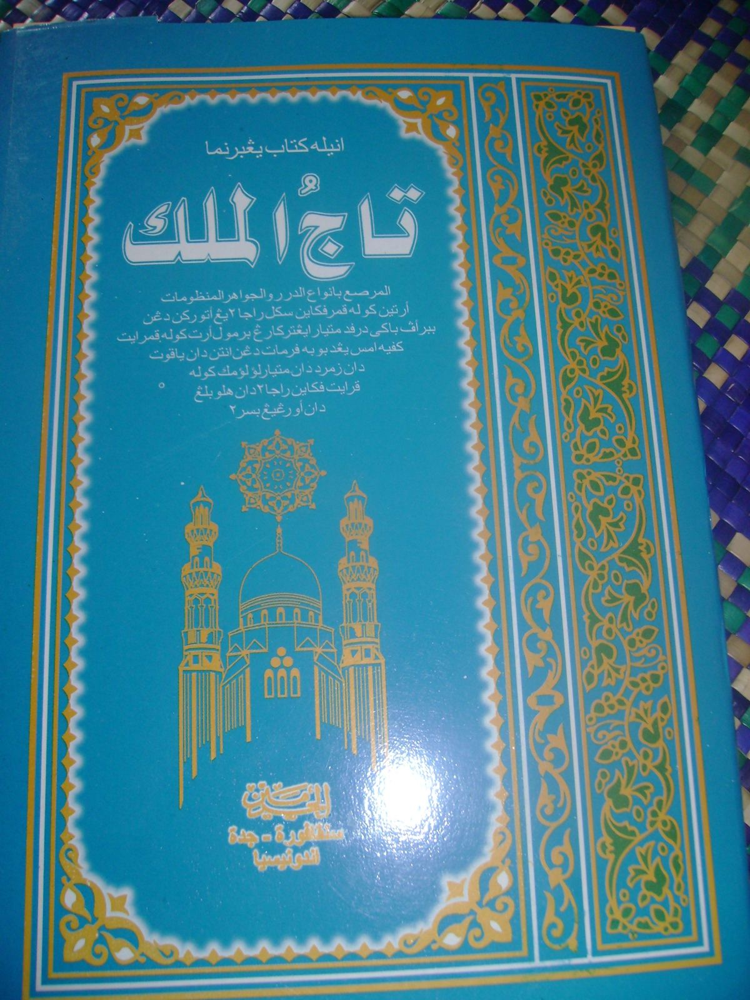

Slide 9
Tgk. Meunasah
Religious Teacher at Meunasah.
Work together with Geuchik/Mukim
Some acts as Imuem Meunasah/Imuem Mukim.

Slide 10
New Tgk.
“Tgk. Aceh” means who sale ganja in Java.
“Tgk. Aceh” means who can be imam because he comes from Aceh.

Slide 11
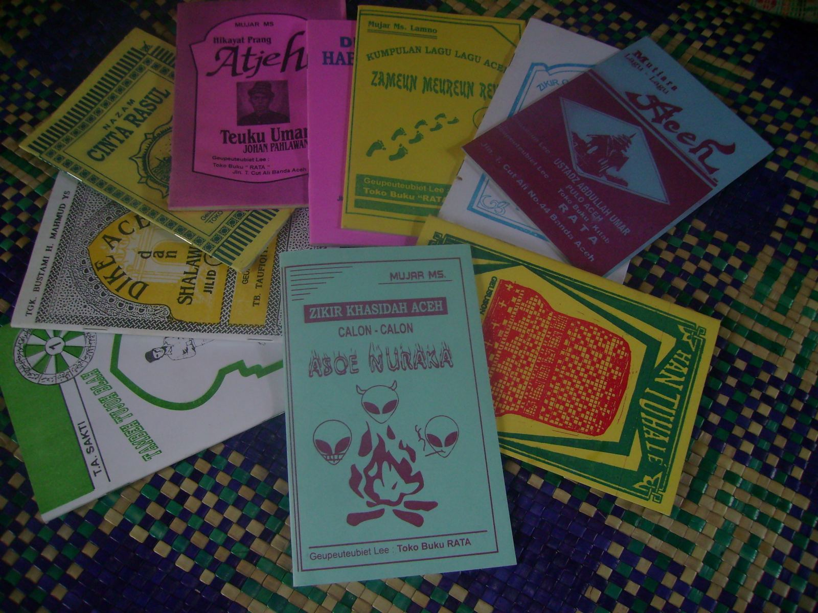

Slide 12
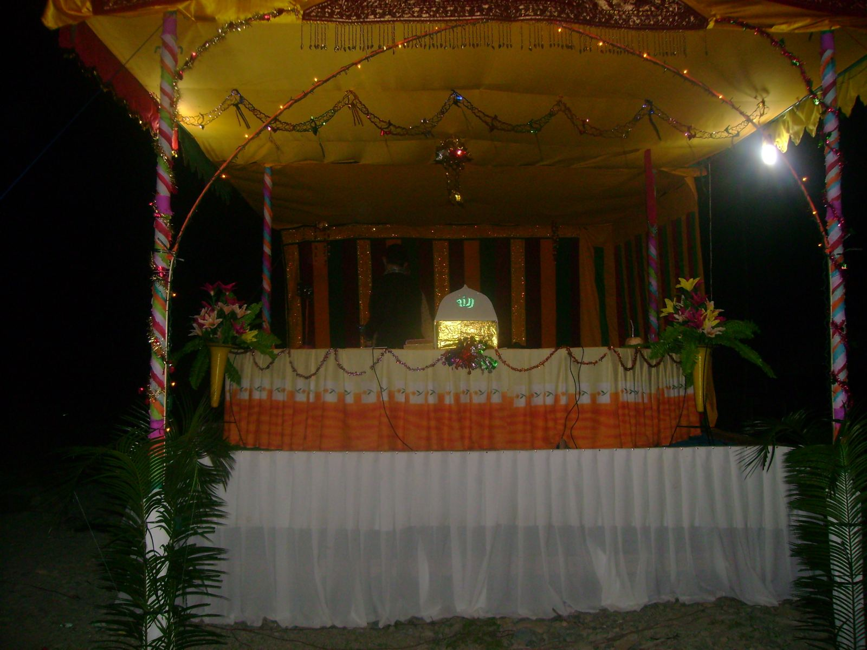

Slide 13
Ustaz
Historically: The network of Gontor Alumni and Middle East.

Slide 14
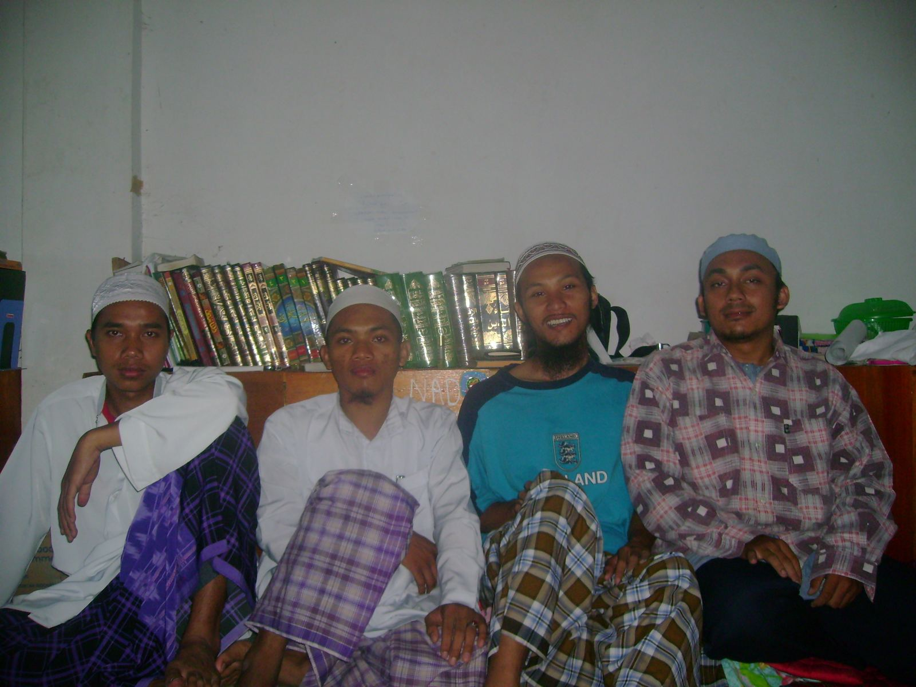
Ustaz among Jama’ah Tabligh

Slide 15
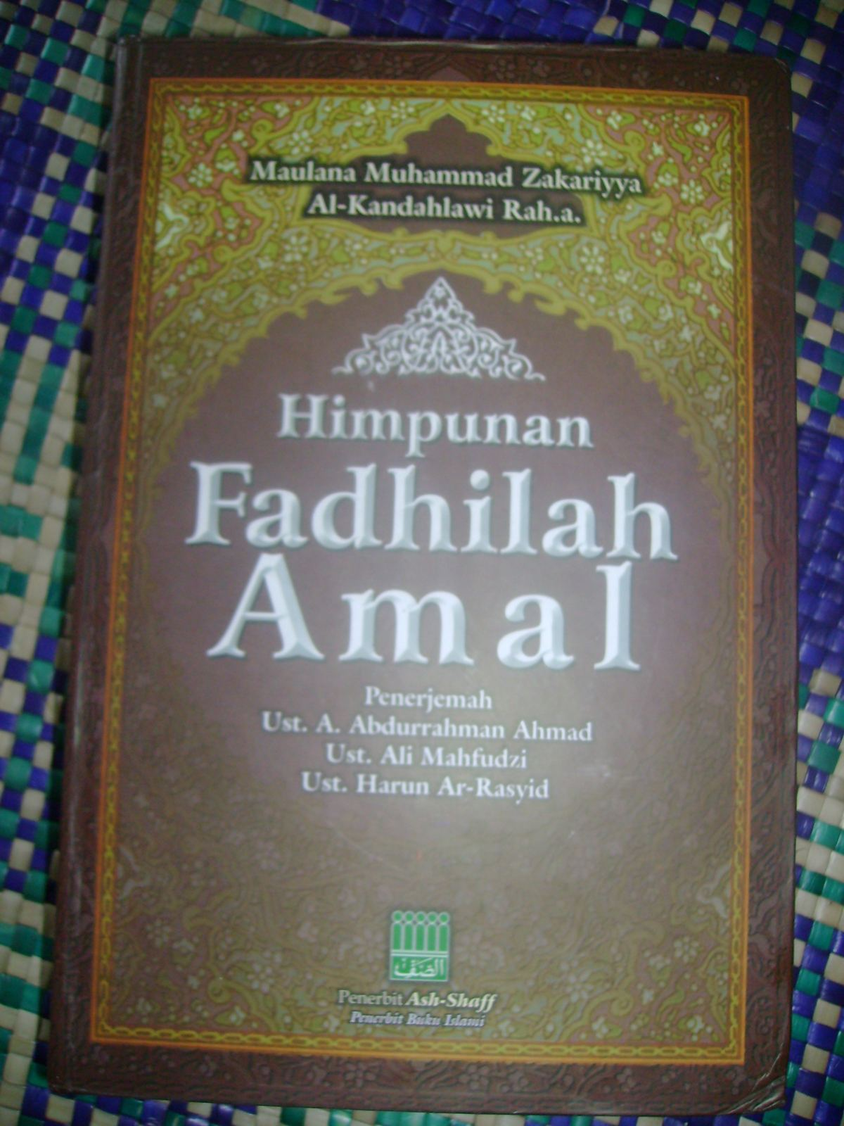

Slide 16
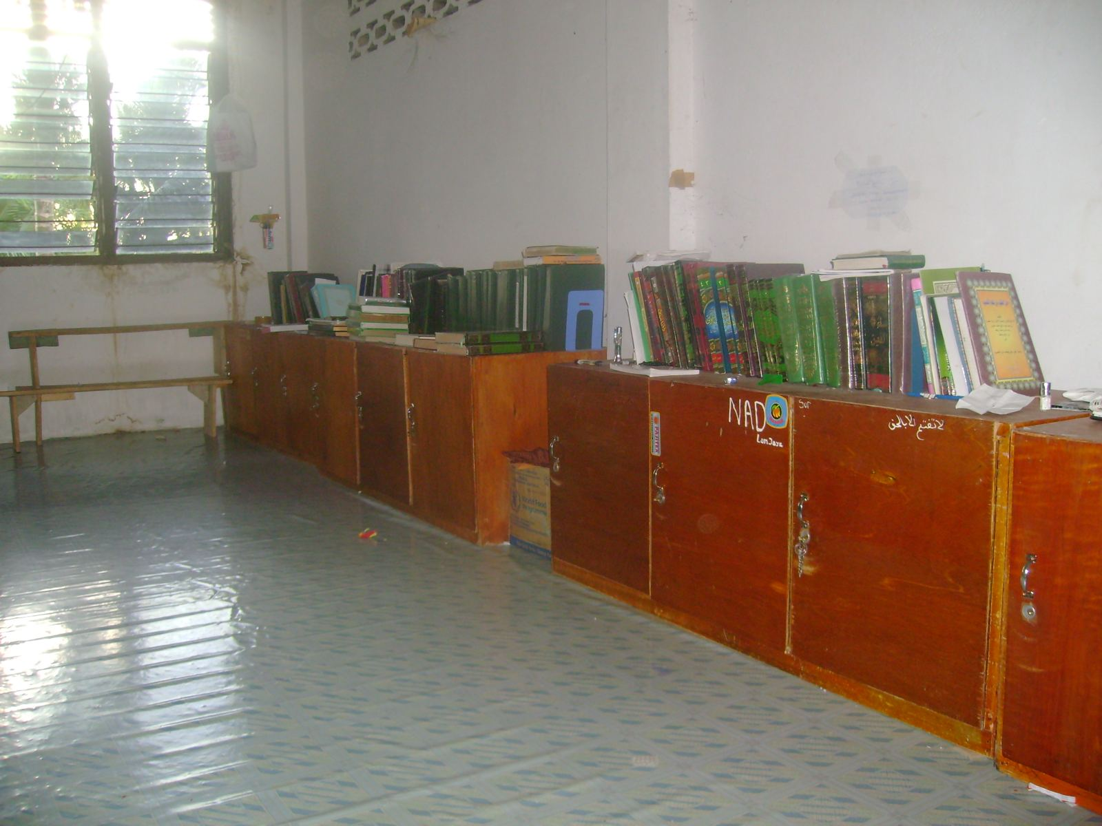

Slide 17
Javanese Ustaz
Coming after the Tsunami
Not only for Islamic education, but also for Dakwah
Part of Wahabism
“Sunnah Connection”
Tend to avoid contact with “Dayah Network.”
Opened cell of Terrorist or Radicalist.

Slide 18
Grand Ustaz
Visit “Sunnah Connection” regularly
Maintains the connection with “Ustaz in Java” and “Ulama in Middle East.”
Sending Acehnese to learn Islâm in Middle East or South Asian.

Slide 19
Conclusion
The title of teungku is more likely to be the heritage of traditional Islamic education. However, there is hierarchy of teungku which is related to their knowledge and influence in society.
The title ustaz is more likely to be an “embedded religious title” in Islamic education in Aceh. It can be traced from the establishment of the pondok modern in Aceh 1980s. Many ustaz arrived in Aceh to work not only in Islamic education, but also in da’wah (Islamic missionary work). There has been a conflict between teungku and ustaz in some sub-districts in Aceh.

Slide 20
Con.
The title of teungku is utilized by some respected GAM members even though they do not have any background in dayah. A GAM member said this title is not part of the identity of dayah people, but of the entire Aceh people .
As for the ustaz group there is a tendency that their arrival in Aceh is not only for the purposes of Islamic teaching but is also part of expanding the terrorist network in Indonesia.

Slide 21
Con.
There is a serious problem in Acehnese society in terms of the sustainability of the Islamic traditional system of education. This is because many parents are eager to send their children to pondok modern, rather than to dayah. Then, they may continue their studies to university level, not only in Aceh, but also in the Middle East. In this situation the role of the dayah has decreased in terms of the development of Islamic studies in Aceh.

Slide 22

Terima kasih

