Slide 1


International Islamic Law Conference 2024
Exploring Islamic law's role in modern global challenges.
by Kamaruzzaman Bustamam-Ahmad

Slide 2
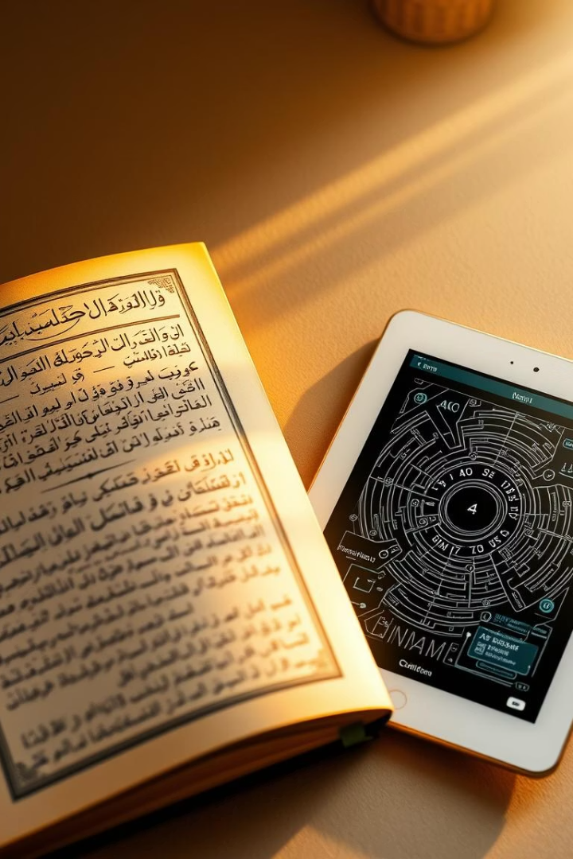
Background and Importance
Dynamic Legal System
Global Relevance
Guides millions worldwide amid globalization and multicultural integration.
Shariah evolves to address modern legal, ethical, and social issues.
Critical Dialogue
Scholars and policymakers engage to keep principles relevant and just.

Slide 3

Key Conference Goals
Encourage Dialogue
On applying Islamic law in modern legal and social systems.
Analyze Challenges
Focus on fintech, bioethics, gender justice, and conflict resolution.
Promote Understanding
Harmonize Islamic law with international legal standards.
Support Emerging Scholars
Provide a platform for innovative research and solutions.

Slide 4
Conference Themes & Topics
Islamic Law in Global Context
Finance & Economics
Aligning Sharia with human rights law
Cryptocurrencies and digital transactions
Migration and refugee rights
Zakat and Waqf for sustainable development
Family Law & Gender Justice
Bioethics & Medical Jurisprudence
Marriage, divorce, inheritance reforms
AI, genetic engineering, organ transplantation
Women's rights and leadership
Ethical health policies
Additional focus on dispute resolution and peace building.

Slide 5
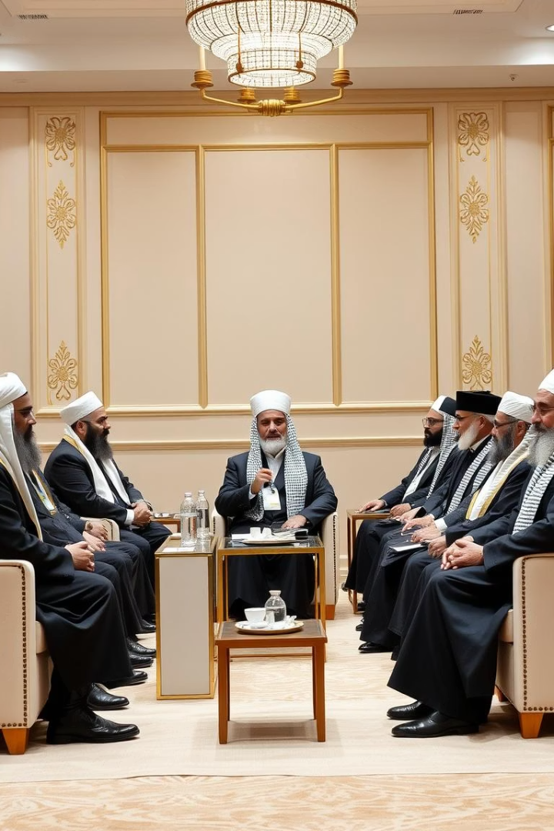




Target Audience & Speakers
Scholars & Researchers
Legal Professionals
Students & Academics
Ulama, Fuqaha, and academic specialists.
Judges, policymakers, and legal experts.
Focused on Islamic studies, law, and political science.
Financial & NGO Representatives
From Islamic financial institutions and NGOs.

Slide 6

Conference Schedule Overview
1
Day 1: Opening & Main Session
Inaugural speech and keynote on Islamic law's future.
2
Day 2: Panels & Workshops
Thematic sessions and legal research methodology workshop.
3
Day 3: Conclusion & Recommendations
Roundtable discussions and closing ceremony.

Slide 7





Expected Results & Outcomes
Published Papers
Policy Recommendations
Networking
Consensus Statement
Selected works indexed internationally.
Opportunities for future collaborations.
For governments and Islamic institutions.
On critical Islamic legal issues.

Slide 8

Invitation to Participate
We invite scholars and practitioners to submit abstracts by the deadline.
Selected authors will be invited to submit full papers for presentation.
This conference marks a milestone in advancing Islamic legal scholarship.

