Slide 1
Up-Date: Peace Process in Aceh
Kamaruzzaman Bustamam-Ahmad

Slide 2
Outline
Why do we need peace in Aceh ?
Experience with Peace Process in Aceh
Cultural change of Acehnese Society
The MOU Helsinki
Challenges
Conclusion

Slide 3
Why?
Conflict has been for more 30 years
Shari’a Law versus Aceh Merdeka
International attention to Aceh
Give me conflict, I will give you gun!

Slide 4
Experience
Military operation (end 1998
Authority Military Operation (1999
Rencong Awareness Military Operation (2000)
Love Mosque military operation (2001)
Humanitarian Pause (2001)
Moratorium
Presidential Instruction (2002)
Martial Law (2004)
Tsunami (2004)

Slide 5
Cultural changes
The Issue of Wali Nanggroe
The establishment of Majelis Adat Aceh
The role of adat institution as “cultural heritage.”

Slide 6
MoU
From GAM to KPA (The Committee Aceh Transition)
From GAM to PA (Aceh Party)
From Weapon to Parliament
From Propaganda to Governor
From Making Bomb to Making Project

Slide 7
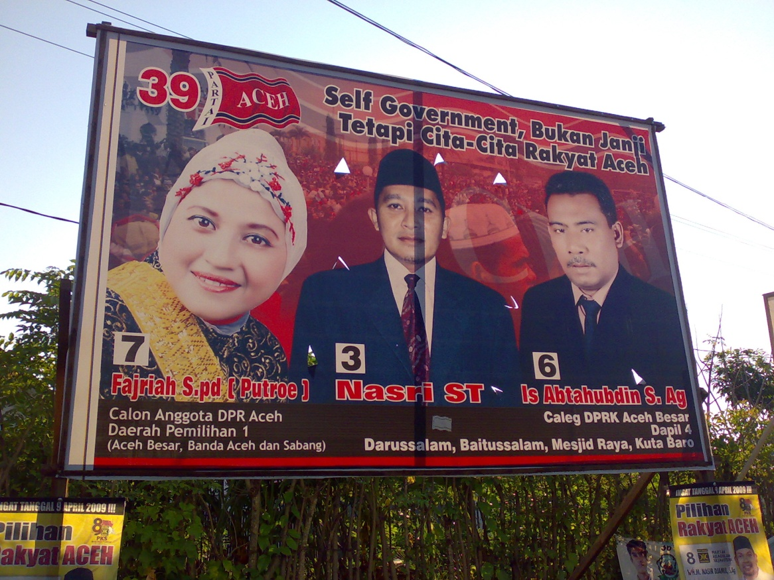

Slide 8
MoU
The Issue of Wali Nanggroe (Guardian of State)
Who will be Wali Nanggroe (?)
Hasan di Tiro passed away on 3 June 2010
From Aceh Nanggroe Aceh Darussalam to Darussalam to Aceh Province (UUPA)

Slide 9
Challenges
Militia trained by Military
Terrorist Issue
The Split of Ex-Combatant
Those are working very close to govt.
Those are dreaming about Merdeka
Return to Society
As criminal

Slide 10
Conclusion
Give me Peace, I will give you a project.
Give me Peace, I will give you a position
Give me Peace, I will give you connection
Give me Peace, I will offer you my gun

