Slide 1
Recent Growth of Religious Intolerance in Indonesia
Kamaruzzaman Bustamam-Ahmad

Slide 2
Aims
To explain the current situation on RI (Religious Intolerance) in RI (Republic of Indonesia).
To introduce a conceptual framework:
Why religious is important in our era?
Is there the problem of RI due to “religous teaching” or “hijacked society”?
To put in concept of some possible agendas in Fostering Peace in SEA

Slide 3
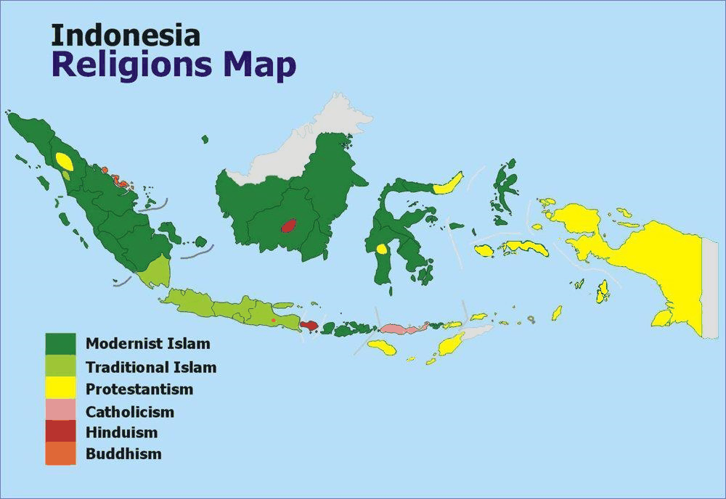
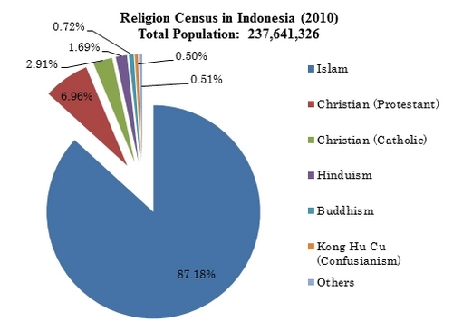
What we know about Indonesia

Slide 4
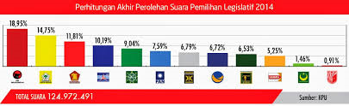
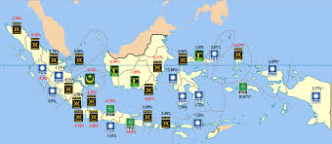
Socio-Political Mapping

Slide 5
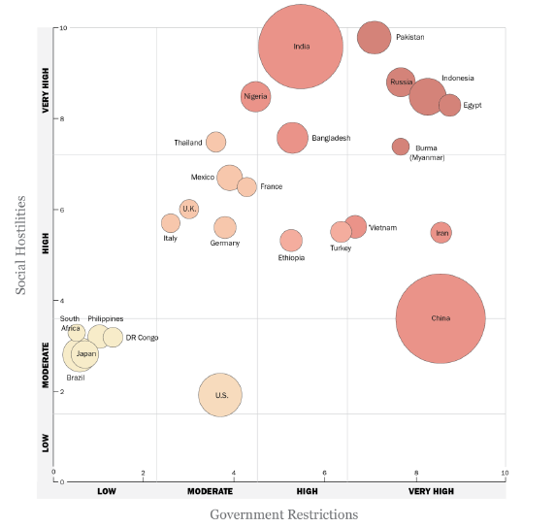

Slide 6
Pew Research Center (2014)
Mob violence also escalated in Indonesia, as Muslim groups targeted houses of worship, religious schools and homes of other Muslims they deemed “unorthodox,” ... In August 2012, for instance, some 500 Sunni hard-liners attacked a Shia community in the city of Sampang, killing two people, burning dozens of homes and displacing hundreds of people

Slide 7
RI in RI
The target of violation (which always targets the minority such as the Ahmadiyya, the Christians, and indigenous faiths);
Its methods (discrimination, physical violence, murder, criminalization,forced relocation, and systematic stigmatization);
The modus operandi (generally, the violation are made legal by discriminatory state legislations, which are a direct attack towards religious freedom)
(Rafendi Djamin, ASEAN Intergovernmental Commission on Human Rights (AICHR).

Slide 8
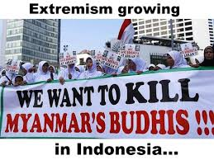
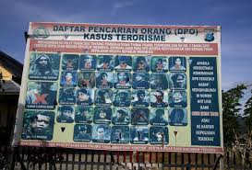
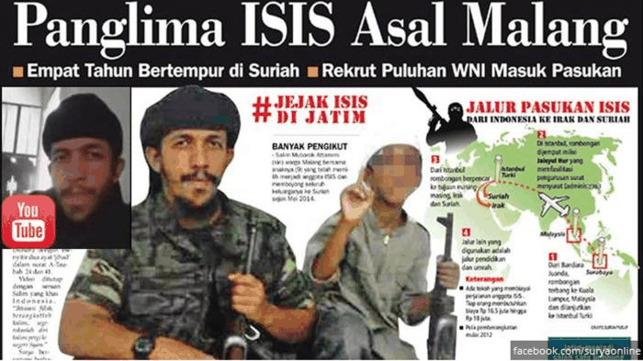
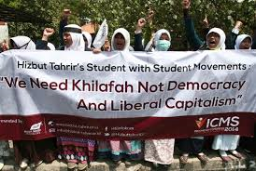
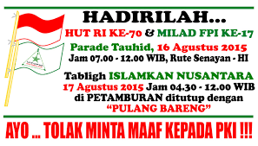
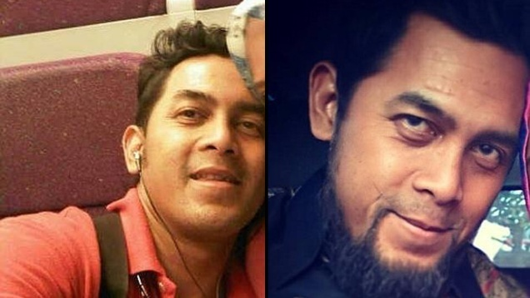
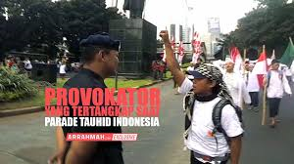
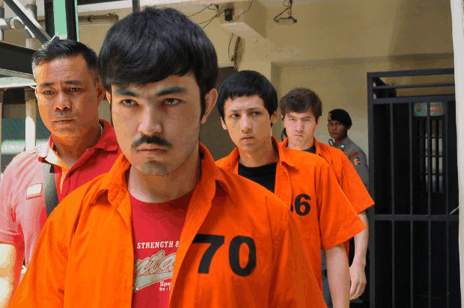
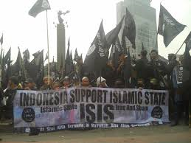
What do we need to know about religious Life in Indonesia?

Slide 9

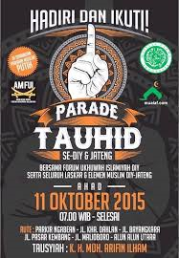
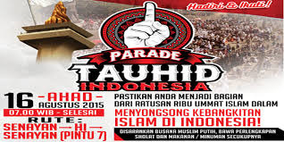

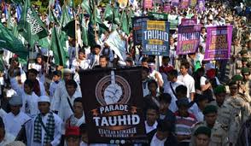
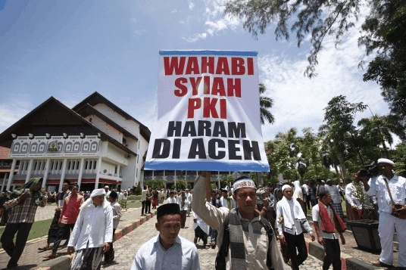
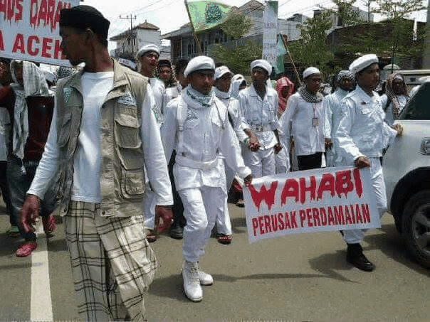
Many Groups, Many Voices

Slide 10
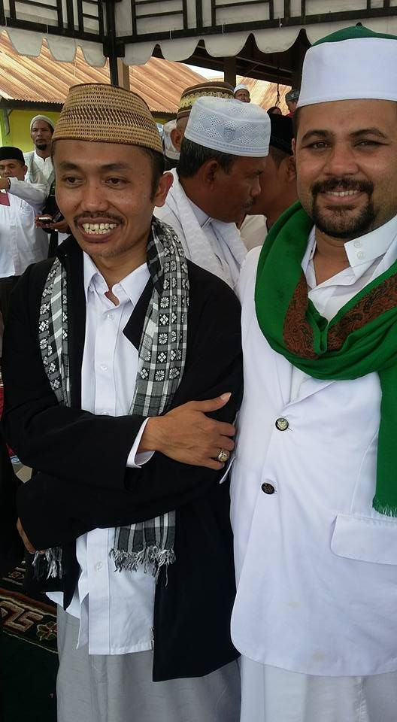
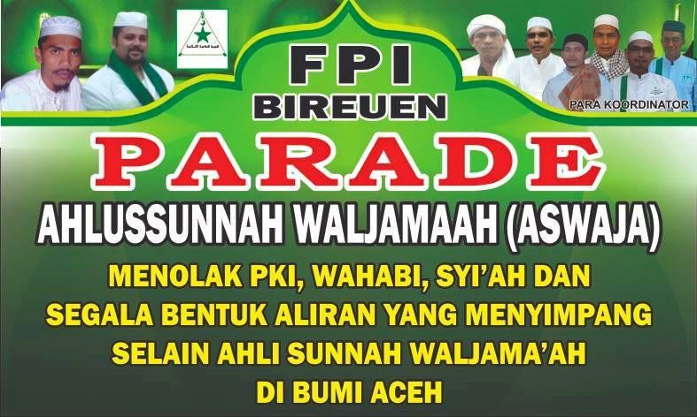
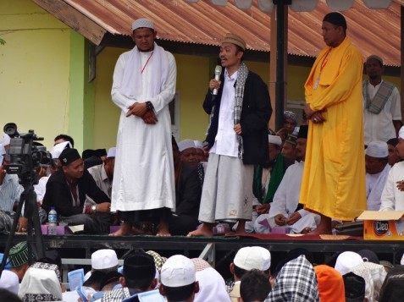
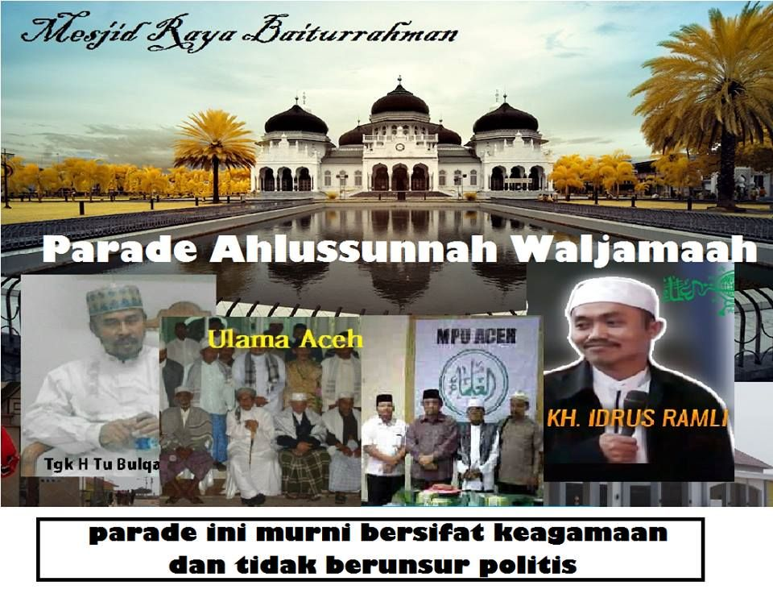
NU-Nization of FPI

Slide 11
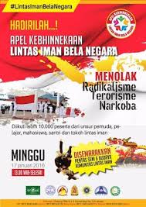
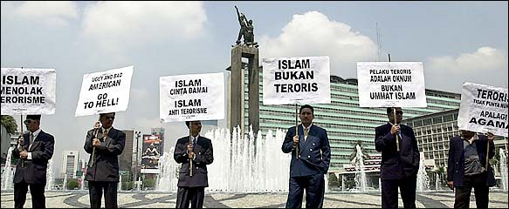
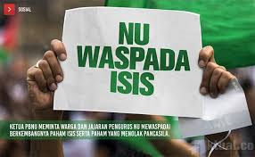
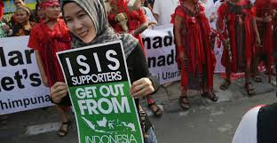
Meanwhile

Slide 12
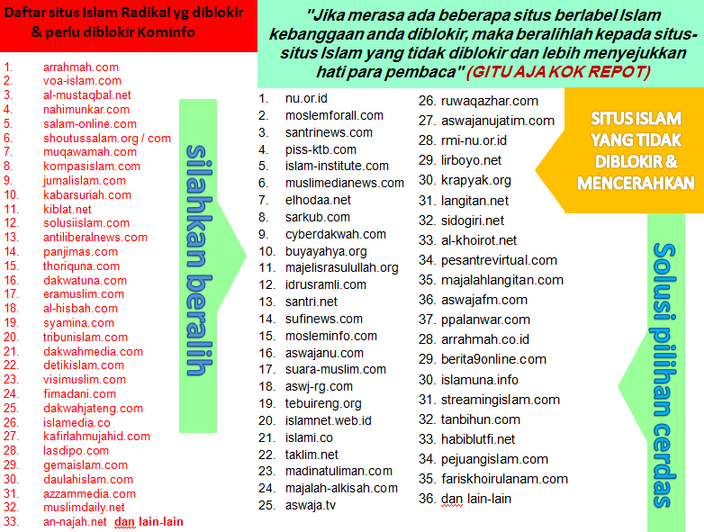


Virtual RI

Slide 13
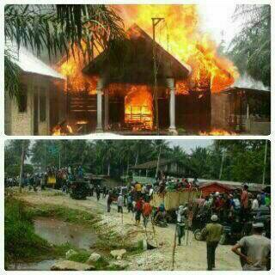
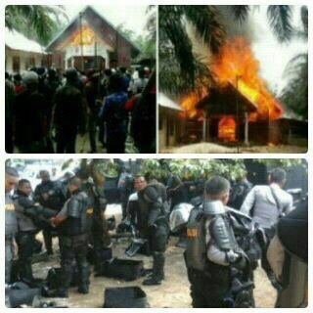
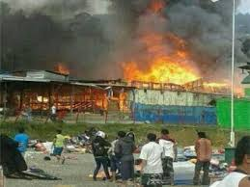
Singkil : The Attack of un-Registered Church in Aceh(October 2015).
Tolikara: the attack of “un-wellcoming” mosque in Papua (July 2015)

Slide 14
Root of Problems or Problem of Roots?
Intellectual
Meaning
Arts
Religion
Culture
Social Action
Behaviour
Moral
Ethics
Values
Spirit
World View/Symbol
Socio-Cultural
Ritual
Reasoning
Conptemplation/Meditation
System of Ideas
Philosophy
Paradigm

Slide 15
The Process of forming World Societies
Traditional
Religion
Magic
Modern (nation state)
Secularism
Post-Modern
Myth
Planetary Civilization
Humanism
Globalism
Glocalization
Global Citizenship
Global Mind
Trans-national values manipulated
Chipization oriented
Plularism

Slide 16
How does RI begin?
Traditional
Culture is understood
Religion as guidance
Post-Modern
Culture is respected
Religions is attracted
Modern
Culture is questioned
Planetary Civilition
Myth as local knowledge
Religion is prohibited
Myth is symbolized
Myth is no longer important
Culture is transformed to be heritage
Religion is fragmented into as new spirit
Myth is changed with the power of Science

Slide 17
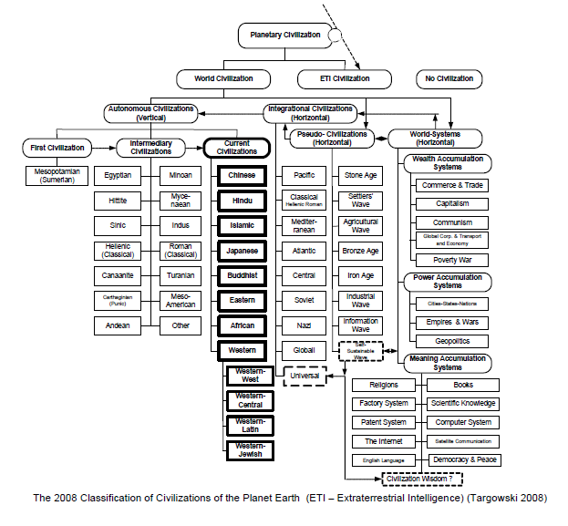

Slide 18
Reproduction of Way of Thinking in Indonesia
Reproduction of Way of Thinking
Cosmology
World View on Micro-Macro Cosmos
Spirit
Soul of Country
Ideology
Knowledge
System of Social Engineering
Nation-State
System of thought
Cosmic Mind
Control of National Mind
Defence

Slide 19
Clash of Values in Indonesia?
Javanism
Chatolicism
Americanism
Islamism

Slide 20
Changing of Order in Indonesia
New Order
Orde Reformasi
President
Bussinesman
Military
Golkar
Bureaucrat
President
Military
Political Party
Media
Bussinessman

Slide 21
Major Problems in RI in RI
Spirit
Ideology
Type of Human
Type of Society
National Strategy

Slide 22
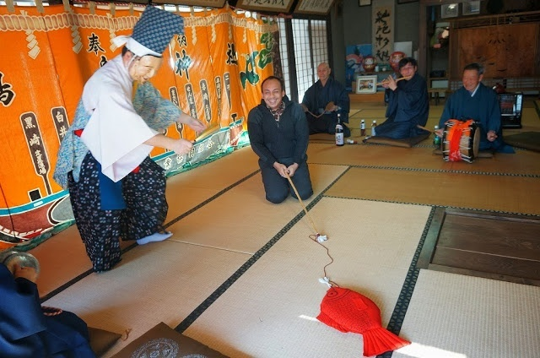
Thank You!

