Slide 1
STRATEGI MENULIS DALAM JURNAL ILMIAH

Slide 2
Level penelitian
Hanya mendeskripsikan data.
Mendeskripsikan data dan mulai menggunakan teori di dalam penelitaannya.
Mendeskripsikan data, tetapi menelaah dengan beberapa teori.
Mendeskripsikan data plus teori, lalu memunculkan suatu teori baru.
Mendeskripsikan data lalu memiliki dampak bagi suatu kebijakan.
Perenungan lalu muncul suatu teori.

Slide 3
Kesusahan saat hendak menulis
Tidak ada inspirasi
Tidak tahu standar penulis karya ilmiah.
Tidak [tahu] atau [punya] rujukan yang terkait.
Menulis seperti hendak berceramah/berpidato.
Jarang masuk ke dalam wacana masyarakat ilmu yang menjadi disiplin keilmuannya.

Slide 4
Merubah Skripsi/Tesis/Disertasi mjd Jurnal
Model penyajian hasil penelitian
Mempublikasikan salah satu bab dalam penelitian tsb.
Mencari judul yang tepat (Beda judul jurnal dengan jurnal)

Slide 5
Tugas dosen Pembimbing
Mengubah tata bahasa
Menteoritasikan hasil penelitian
Meng-up-grade dari hasil penelitian ke diskursus keilmuan.
Memasukkan karya mahasiswa-nya dalam komunitas ilmuwan (sesuai dengan disiplin).

Slide 6
Pengalaman
Artikel ilmiah yang pertama kali dimuat, telah direvisi 6-7 kali.
Dimuat karena perkawanan ilmu.
Dua artikel dalam bahasa Inggris, harus diedit bahasanya oleh native speaker ( 2 juta).
Ditolak dalam beberapa jurnal internasional, karena:
skop jurnal tersebut bukan untuk spesifikasi tulisan saya
Tidak ada teori baru.
Tidak dikenali penulis,
Gap geografis.
Tidak punya jaringan dalam jurnal tersebut.
Tidak ada berita sama sekali.

Slide 7
Pengalaman
Skripsi (Profetika dan Pemikir)
Tesis (Al-Jami’ah dan Kyoto Review)
Disertasi (Book Chapter, Al-Jami’ah, Studia Islamika, Oxford Islamic Studies Online).

Slide 8
Jadi,
Menulis di jurnal ilmiah memang menguras energi.
Memerlukan persiapan.
Rajin berkonsultasi
Perlu play maker yang memperkenalkan kita ke komunitas ilmu.

Slide 9
Jenis artikel dalam jurnal ilmiah
Artikel teoritik;
Perdebatan di satu bidang ilmu oleh para pakar
Artikel berisi hasil penelitian lapangan.
Review Article
Book review
Thematic article
Contemplative article

Slide 10
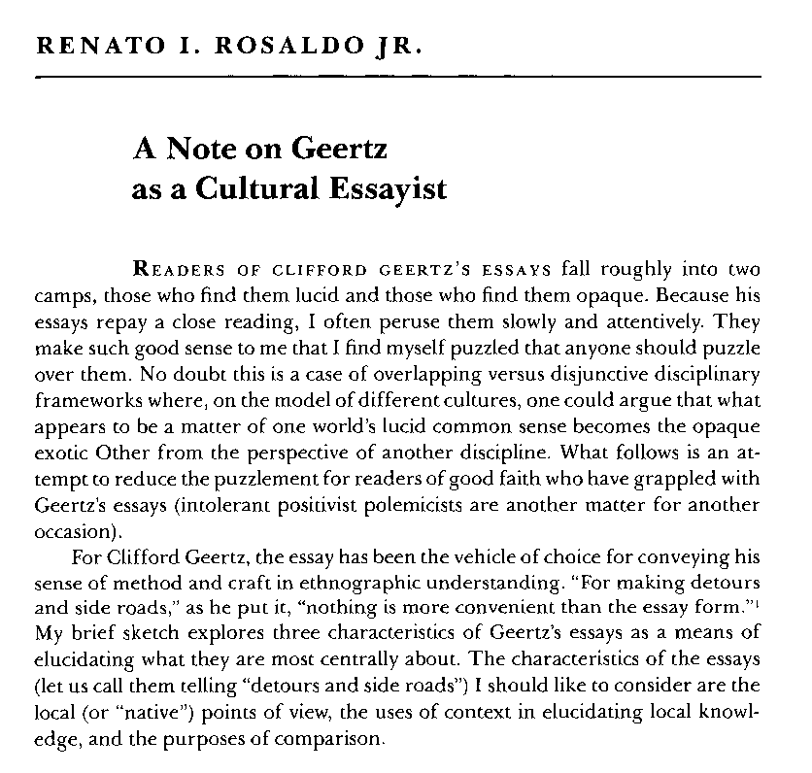

Slide 11
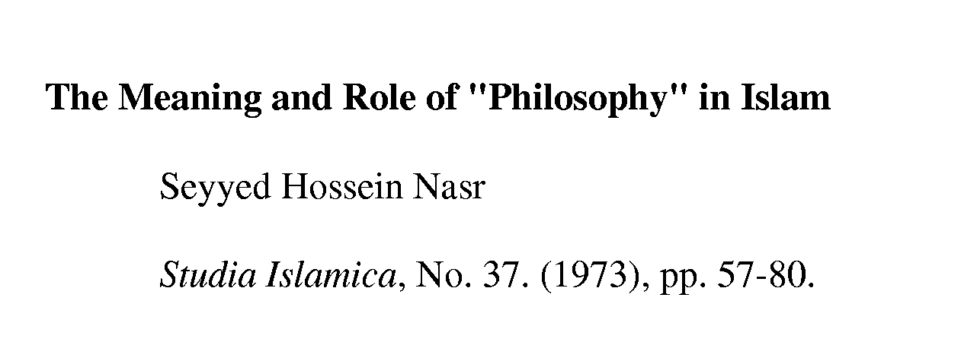
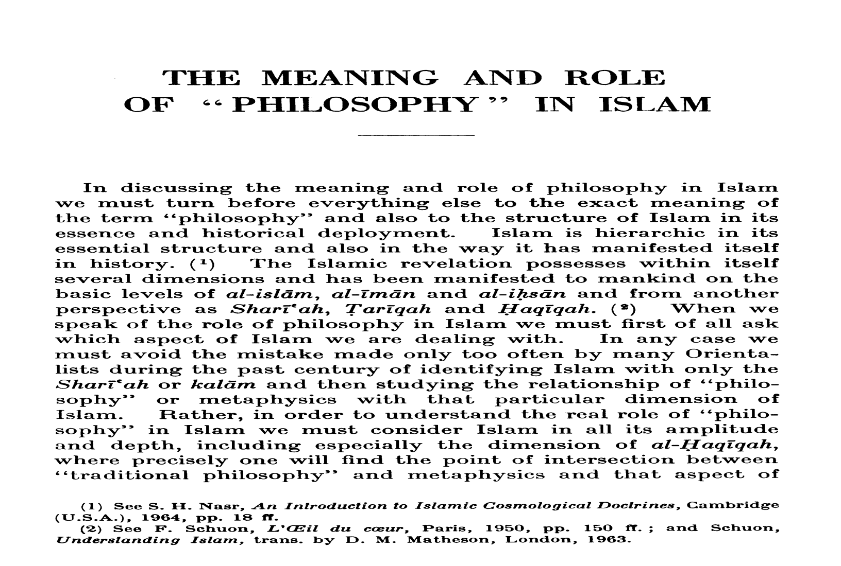

Slide 12
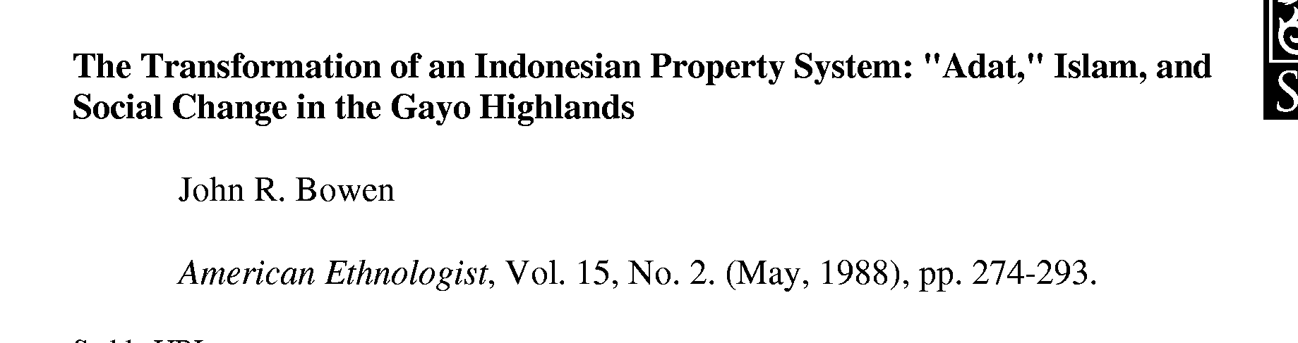
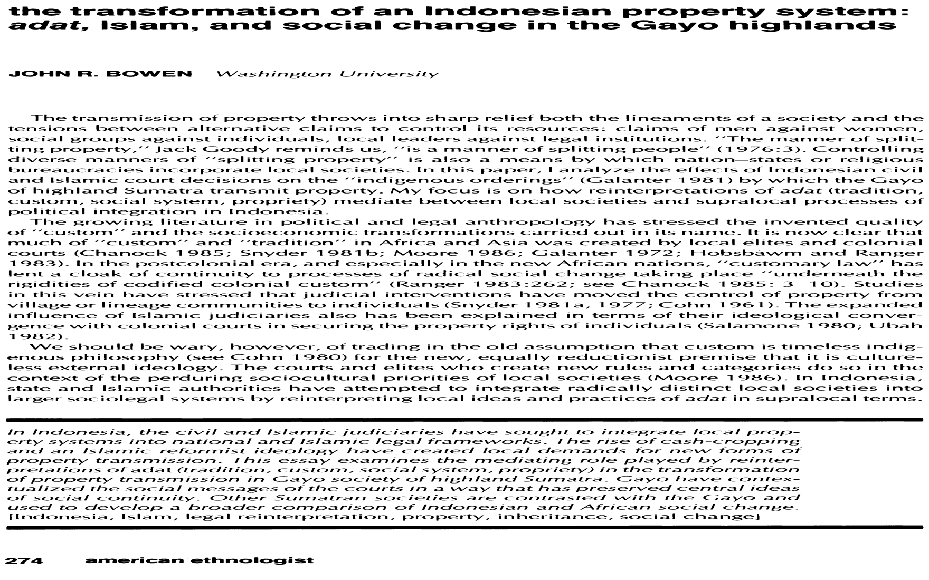

Slide 13
Scientific writing in general
Subject
Purpose
  to exchange the scientific knowledge
  to ask and answer specific questions
Audience
  scientists and those interested in the subject
  a publisher or an editor

Slide 14

IMRAD format
Introduction
Methods
Results And
Discussion
What problem was studied? What others and you did?
How do you did it?
What you found out?
What your findings mean?... and future plans
Remember: writing helps you to think and to learn. Don’t misjudge your audience. They can tell you when you are bluffing and when you don’t believe what are you saying or doing. Write clear and simple, the science is not an entertainment.

Slide 15
Artikel Ilmiah
Judul,
identitas penulis
Abtsrak (biasanya berisi 250-300 kata)
Pendahuluan
Pembahasan
Tujuan penulisan, latar belakang, metode, data, argumen, dan kontribusi
Kesimpulan
Berisi tentang gambaran kajian, studi terkini, perdebatan ilmiah, tujuan kajian, dan argumen, serta struktur kajian
Daftar Pustaka
Hasil kajian yang beriri temuan dan pendapat inti dari seorang penulis
Isi gagasan yang hendak dibuktikan/ditelaah/sesuai dengan kerangka yang sudah disusu
Beriri semua rujukan yang digunakan selama menulis.

Slide 16
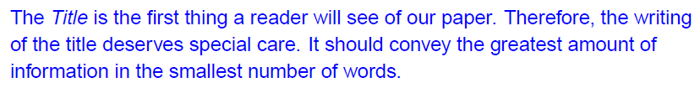
Paper organisation
Title
Author experience: Not much problem. Title should be concise, interesting and could be provocative!

Slide 17
Tips for Title
Less than 10 words.
Reflect the factual content of the paper.
Uses key words that researchers in the field will recognize.
Consider search engines – if you were looking for this article, what key words would you use?

Slide 18
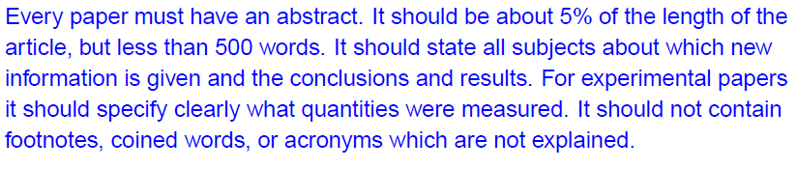
Paper organisation
Abstract
Author experience: Not much problem. Abstract should be around 300 words, with the highly of research background & finding.

Slide 19
Abstracts
Descriptive abstract
  or topical abstract, describes the contents but contains too little substance and detail
Informative abstract
  self-explanatory report on a scientific investigation (research objectives for conducting the investigation, the basic method used, and the results and significant conclusions) - 200 to 250 words
Extended abstract (conference proceedings)

Slide 20
Contoh Abstrak
Artikel ini bertujuan untuk memamahami apakah masih ada isu separatisme di Aceh, paska penandatangan MoU Helsinki, 15 Agustus 2005 (TUJUAN ARTIKEL). Harus diakui, bahwa di kalangan GAM tersendiri telah terpecah ke dalam beberapa kelompok dan juga partai politik. Perpecahan ini tentu saja menyiratkan satu persoalan mengenai keinginan beberapa kalangan orang Aceh untuk tetap ingin memisahkan diri dari Negara Kesatuan Republik Indonesia. Potret konflik di kalangan GAM ternyata menyisakan satu persoalan baru yaitu kebangkitan kelompok neo-GAM yang memandang bahwa perdamaian ini bukanlah target mereka, sejak gerakan ini didirikan pada 1976 (LATAR BELAKANG DAN PEMBATASAN MASALAH YANG DIKAJI). Adapun data yang disajikan dari kajian ini berasal dari hasil investigasi selama beberapa tahun terakhir, baik di dalam maupun di luar negeri. Dalam hal ini, wawancara dan observasi telah dilakukan dengan beberapa kelompok mantan kombatan dan juga eksponen GAM yang pernah berdiam di luar negeri (SUMBER DATA). Disamping itu, metode etnografi telah dilakukan di beberapa kawasan di Aceh, untuk melihat persepsi rakyat Aceh (METODE). Adapun argumen yang hendak dibangun adalah orang Aceh harus mampu “menyeimbangkan” kepentingan internasional dan nasional di dalam melakukan manajemen konflik di Aceh. Isu separatisme telah dijadikan sebagai bahan komoditi baru di Asia Tenggara (HASIL PENELITIAN). Selain itu, pandangan lain yang hendak dituangkan adalah bahwa polarisasi gerakan sosial politik di Aceh memang tidak pernah jauh dari teori-teori Marxis (KONTRIBUSI TEORITIK).

Slide 21
THE APPLICATION OF ISLAMIC LAW IN INDONESIA: The Case Study of Aceh
Kamaruzzaman Bustamam-Ahmad
La Trobe University - Australia
Abstract:
This article provides an historical account of the implementation of Islamic law in Aceh and how the issue of Islamic law has been debated. The study will give more emphasis on the dynamics of the implementation of Islamic law, its historical development, typologies of Islamic law, leaders’ opinions regarding this issue, and the governments’ responses. This study argues that Islamic law in Aceh has been misinterpreted merely as h{udud law. In addition, it argues that the provincial government tends to put heavy emphasis on symbolic religious issues (such as the Islamic dress code and the usage of Arabic signs and letterheads), rather than the substance of Islamic law such as justice and prosperity for all. Finally, the study has made evident that implementing Islamic law is never a good method of attempting to resolve conflict. There is no need to establish Islamic law formally through the political process because, when politics enters in religious arena, it carries with it many interests.
Keywords: Aceh, Shari‘ah, Qanun, Adat, Hudud.

Slide 22
Tips for Abstract
Purpose: allows the reader to quickly judge whether the article will serve his or her needs.
Concise (100 – 200 words).
Provided at the beginning.
Summarizes the purpose of the report, the data presented, and the author’s major conclusions.

Slide 23
Paper organisation
Introduction
  call attention to the specific subject, define the problem
  provide background and present the results of other studies (literature review)
  list the structure of your research project and what you plan to present in your paper
Reading a scientific article isn’t the same as reading a detective story. We want to
know from the start that the butler did it (Ratnoff, 1981)

Slide 24
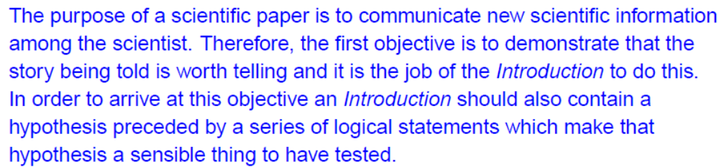
Purpose of Introduction
Author experience: Often make problem! Introduction should be contain logical thinking in related to existing research & technology.

Slide 25
The Most Important Part of Your Paper: the Introduction
The 1/3 – 2/3 Rule from a reviewer’s perspective:
  1/3 time to read your introduction and make a decision
  Remaining 2/3 time to find evidence for the decision
A good introduction with a good motivation is half of your success!
What to cover in the introduction
  The research problem
  The motivation of your research on the research problem
  The claim of your contribution
  A summary of your evidence to support your claim
  The significance of your contribution
  An outline of the rest of the paper.

Slide 26
Tips for Introduction
1. General setting
… have long been used as
2. Purpose of research
The purpose of the present research was to
3. Literature review
(citation) demonstrated that
4. Indication of a gap or extension of previous knowledge
However, few researchers have reported

Slide 27
Introduction
5. Rationale
A reason for this study is to
6. Major findings and results
The results show that
7. Main features of research
In this paper, a … is developed
8. Value of research
…would greatly improve
9. Content and organization to follow
…in the following sections

Slide 28
Paper organization
Methods
  complete information of materials and methods used, conditions present, actions, experimental design, etc.
  this section usually has subheadings; when possible match those to be used in Results
  enough information must be given so that the experiments could be reproduced
  ask a colleague if he/she can follow the methodology

Slide 29
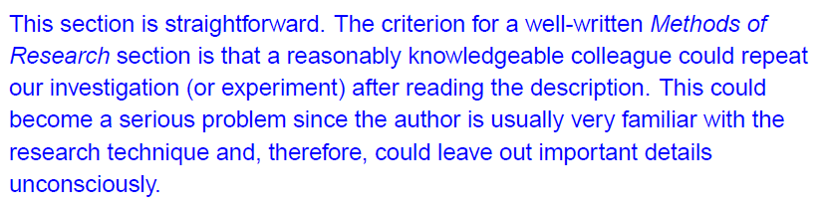
Methods
Author experience: Often make problem! Method should be contain the important details of the experimentation.

Slide 30
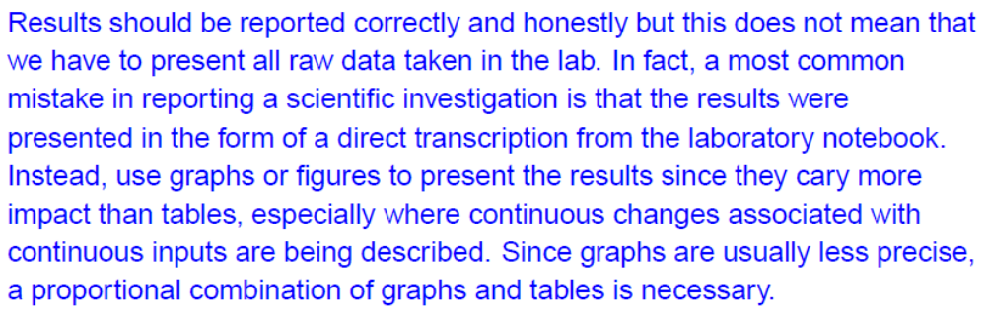
Results
Author experience: Very often make problem! Results always as a focus of the referees evaluation. Be careful with this part.

Slide 31
In-Depth Analysis of Empirical Results
Enough details for your experiment settings (so that other researchers can verify and improve your results)
What were the alternatives considered at various points of your experiments? Why and how have you made the choices for your experiments?
Are the experimental results consistent and conclusive?
Can you fine-tune some key parameters to get better or worse results? If so, use figures and tables to show their impacts on your system performances
How do the experimental results correspond to the motivation of the paper?
What have you found surprising and tried to avoid in these experiments? How generally applicable are these lessons?

Slide 32
Tips for Results
1. Overall description of the investigation
Analyses were conducted using
2. Location of figures and tables
… be presented in Fig. (number)
3. Presentation of important findings and results
As can be seen in Fig.(number)
4. Comments on the results
These results suggest that

Slide 33
Paper organization
Discussion
  the hardest section to write, you discuss, you do not recapitulate the Results
  show the relationship among observed facts
  state your conclusion as clearly as possible
  summarize your evidence for each conclusion
  end with a short summary/conclusion regarding the significance of your work

Slide 34
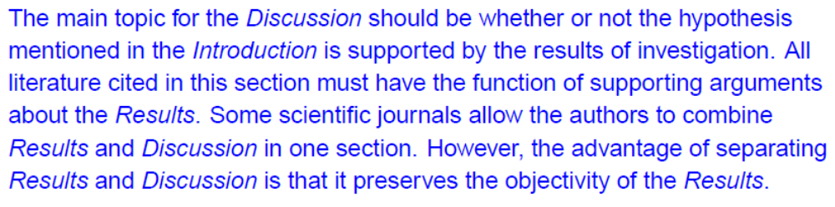
Discussion
Author experience: Very often make problem! Discussions always as a focus of the referees evaluation too. Be criticize with this part.

Slide 35
Tips for Discussions
1. Background information
An effort has been made to
2. Statement of results
It has been shown that
3. Expected or unexpected outcome
Unfortunately, we were not able to
4. Reference to previous research
This is in good agreement with (citation)

Slide 36
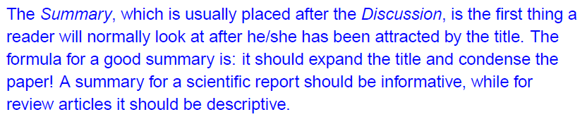
Conclusions or Summary
Author experience: Not make much problem! Conclusions should be short and informative.

Slide 37
Tips for Conclusions
1. Explanation
In view of the fact that
2. Deductions, generalizations, and applications
It can be concluded that
3. Recommendations
… be still needed for future…

Slide 38
Tips for Materials and Methods
1. Overview or design of the investigation
Experiments were undertaken to
2. Methods, approaches, models, techniques, or systems
… techniques were used to
3. Population, samples, or subjects
Samples of … were collected from
4. Location, time, or figures and tables
This is illustrated in Fig. (number), where
5. Experimental conditions, criteria, or hypotheses
It is assumed that

Slide 39
Materials and Methods
6. Procedure
Several steps were taken to
7. Materials or equipment
… be measured using
8. Variables, equations, or measurements
The equation for … is as follows: …where
9. Tests
Tests were performed
10. Comparison with other studies
The same … has been reported in (citation)

Slide 40
Paper organization
Results
  display of data with logical development showing how your findings satisfy your objectives
  where possible give illustrative examples and compare those with known results from literature
  use tables and figures
  ”the fool collects facts; the wise man selects them” (J. W. Powell, 1888)

Slide 41
Results
Author experience: Very often make problem! Results always as a focus of the referees evaluation. Be careful with this part.

Slide 42
In-Depth Analysis of Empirical Results
Enough details for your experiment settings (so that other researchers can verify and improve your results)
What were the alternatives considered at various points of your experiments? Why and how have you made the choices for your experiments?
Are the experimental results consistent and conclusive?
Can you fine-tune some key parameters to get better or worse results? If so, use figures and tables to show their impacts on your system performances
How do the experimental results correspond to the motivation of the paper?
What have you found surprising and tried to avoid in these experiments? How generally applicable are these lessons?

Slide 43
Tips for Results
1. Overall description of the investigation
Analyses were conducted using
2. Location of figures and tables
… be presented in Fig. (number)
3. Presentation of important findings and results
As can be seen in Fig.(number)
4. Comments on the results
These results suggest that

Slide 44
Paper organization
Discussion
  the hardest section to write, you discuss, you do not recapitulate the Results
  show the relationship among observed facts
  state your conclusion as clearly as possible
  summarize your evidence for each conclusion
  end with a short summary/conclusion regarding the significance of your work

Slide 45
Discussion
Author experience: Very often make problem! Discussions always as a focus of the referees evaluation too. Be criticize with this part.

Slide 46
Tips for Discussions
1. Background information
An effort has been made to
2. Statement of results
It has been shown that
3. Expected or unexpected outcome
Unfortunately, we were not able to
4. Reference to previous research
This is in good agreement with (citation)

Slide 47
Conclusions or Summary
Author experience: Not make much problem! Conclusions should be short and informative.

Slide 48
Tips for Conclusions
1. Explanation
In view of the fact that
2. Deductions, generalizations, and applications
It can be concluded that
3. Recommendations
… be still needed for future…

Slide 49
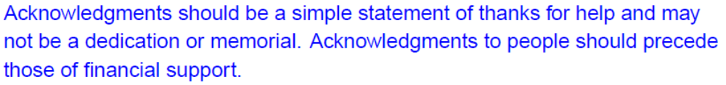
Acknowledgments
Author experience: Not make problem! But don’t forget this part.

Slide 50
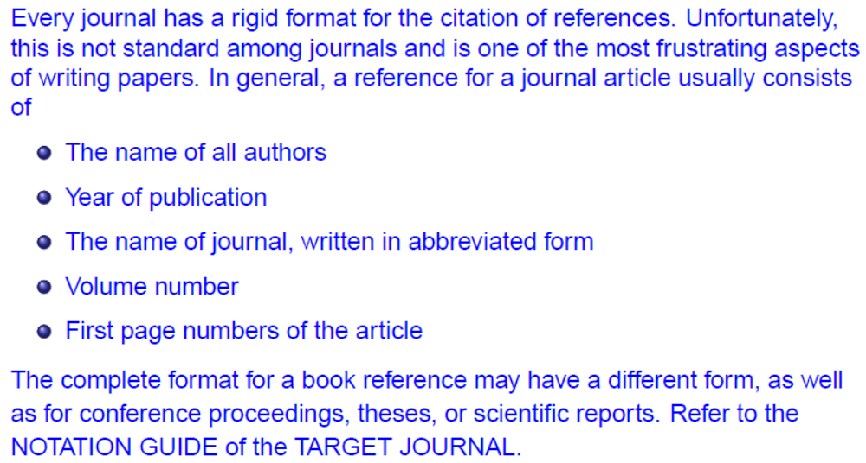
References
Author experience: Not make problem! It should follow the guideline and be consistent.

Slide 51
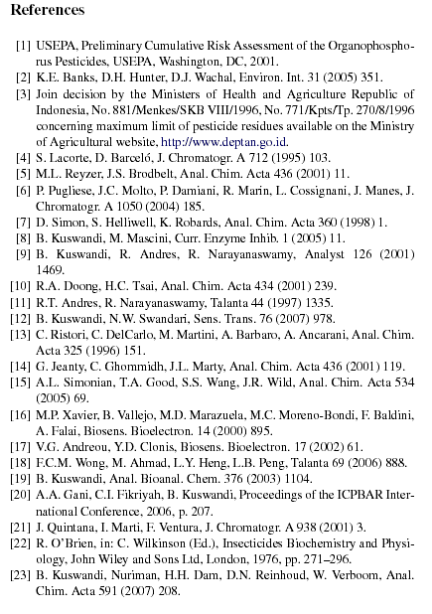

Slide 52
Tips about references…
Showing command of the literature is extremely important. You need to describe the foundation on which your contribution to human knowledge is based. Extensive referencing is the scholarly and ethical thing to do, it’s also useful to readers and it makes your paper more accessible by search engines!
So be serious about literature search and reading papers – devote a bit of time to this each day. Use search engines (like SCI) to search forward in time.
Never cite a paper for which you haven’t read at least the relevant part.
Cite papers in a context that makes it clear what the paper did – otherwise the reference is useless. If you’re not clear on what the paper you’re citing actually did, go back and (re-)read the paper – it’s the intellectually honest thing to do and you may learn something.
Don’t cite textbooks – they may be difficult for reader to access, information may be buried.
There’s nothing wrong with citing yourself or your group extensively – in fact that’s normal since that’s the work you typically build on, and that’s part of advertising. But don’t ignore what others have done!
References should be helpful to the reader, not of historical interest (unless you’re writing a review)

Slide 53
Citations and references
For a better credibility you have to review the literature and show that your contribution extends from a solid foundation of research
Quality and quantity of the sources you have consulted will enhance your work
You have make it possible for readers to retrace your steps
Your references can be as valuable as your research methods and findings
At least three citation styles (in-text citations) and 100 reference styles are commonly used

