Slide 1
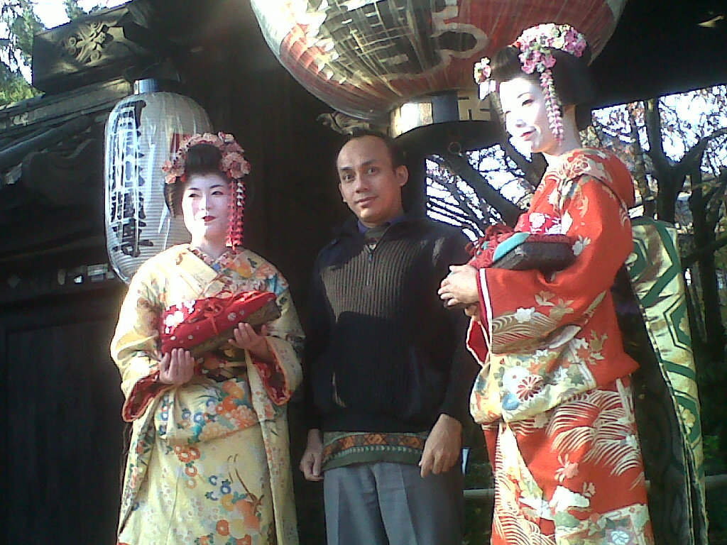
Reflection

Slide 2
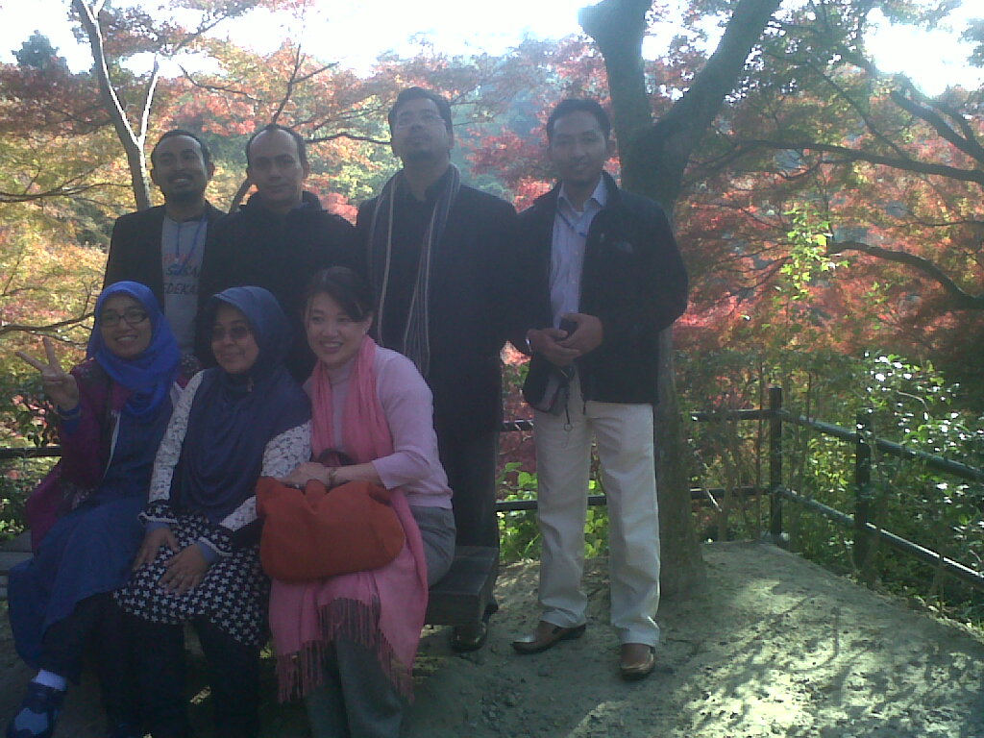
The Program
“The Religious Mentality as a Foundation for building Relationship”
We as “the next generation of Muslim Intellectuals”
Aim to “build network between Japan of Southeast Asia”

Slide 3
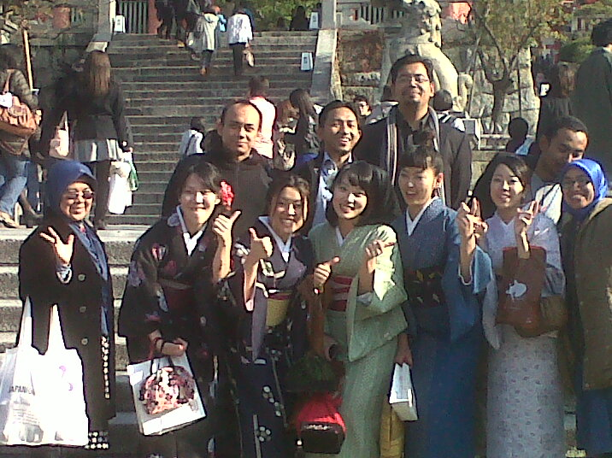
What we have done?
Listening to lesson:
Religion in Japan,
Islam as Area Studies,
Religion and Education,
Religion and Society,
Religion as Culture,
Religion as Archeology
Religion as Ritual,
Religion as Spirit of Society.

Slide 4
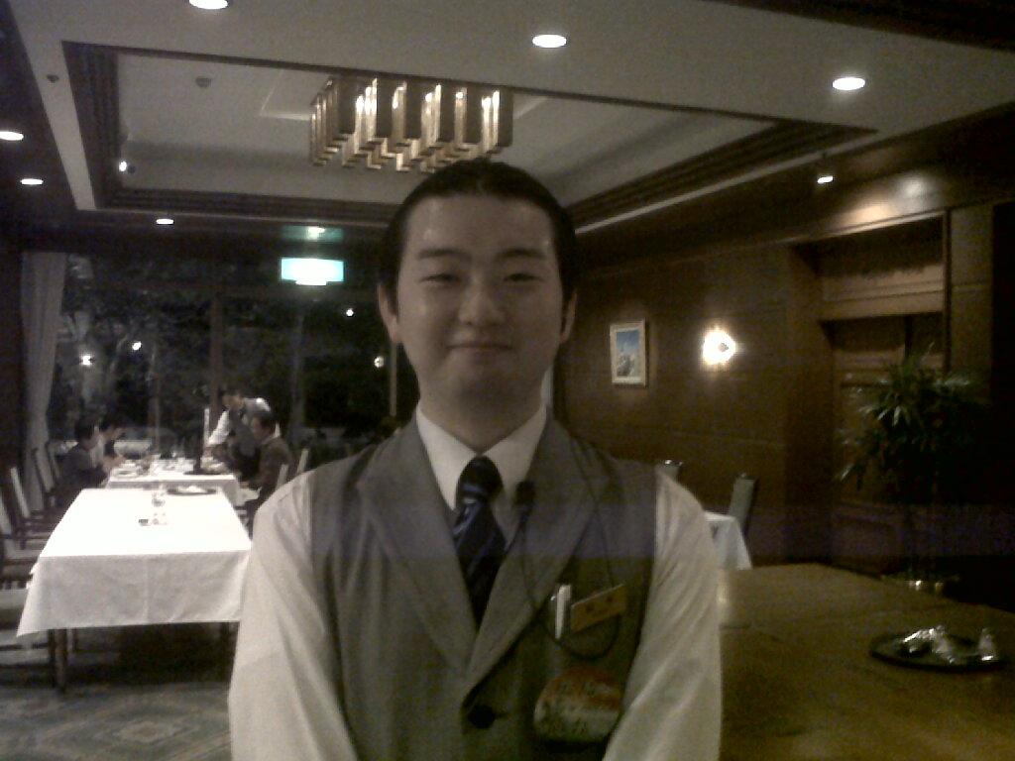
Visiting: Temples, University, NGO, Society, Tsunami areas, hotels, Tea Ceremony,

Slide 5
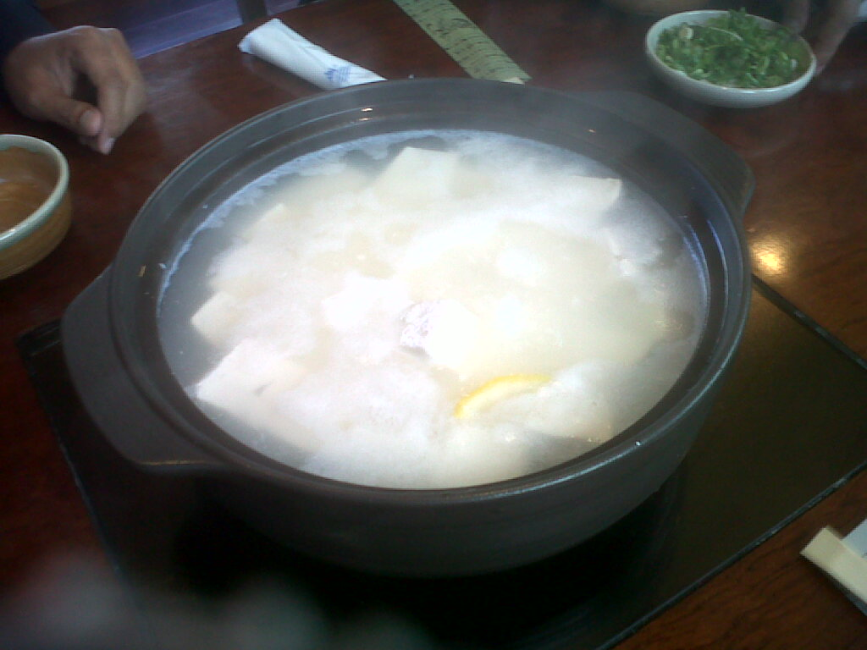
What we are always talking about?
Sense, Master, Comedian, Sumo, Ninja, Sinchan, Oshin, Doraemon, peacefully, and hot spring.
16 Years, 4 hours, 50 years.

Slide 6
Lesson learned
Religion not as “contested idea” or “political tools” (compare to Indonesia and Malaysia).
Privatization of religion,
Culturalization of religion,
Culturalization of spirit from religion
There are some common issues:
“Japanese Religion” with “Javanese Religion” (Buddha, Hindu, Indegenous religion, local wisdom, local cosmic).
Goddes (Sea and Mountain).
The installment of religion to Japanese society after 3.11.

Slide 7
Intellectual
Philosophy
Arts
Religion
Culture
Social Action
Behaviour
Moral
Ethics
Values
Japanese Spirit
World View
Socio-Cultural
Ritual
Reasoning
Conptemplation/Meditation
System of Ideas
Philosophy
Paradigm

Slide 8
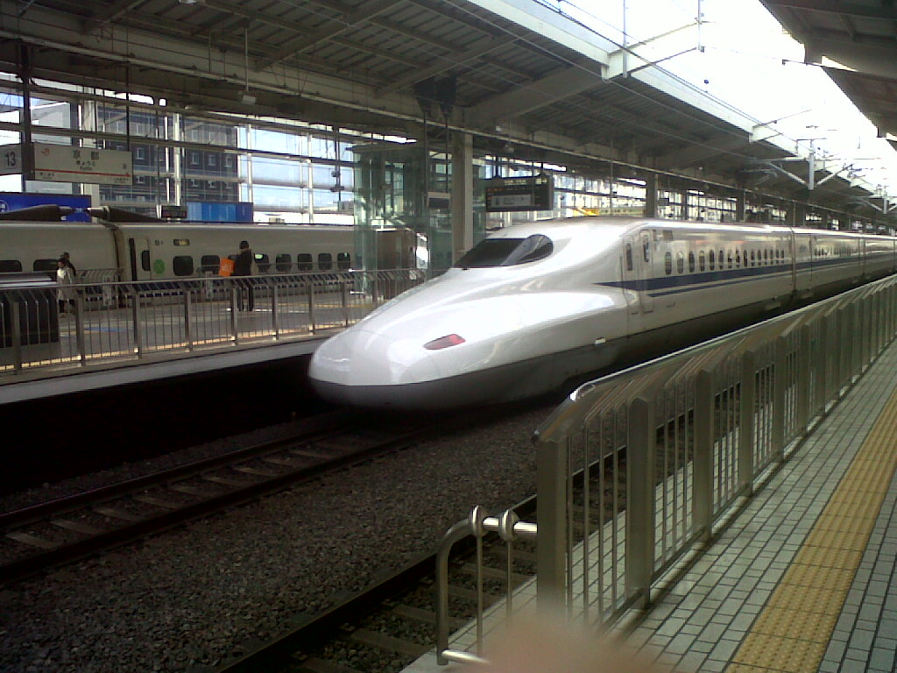
What we can do?
Forming a New Society in the Planetary Civilization.
Dialogue in every level of mutual understanding of spirit.

Slide 9
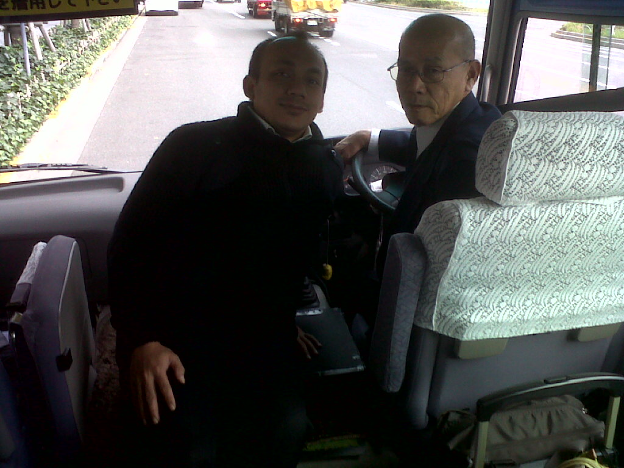
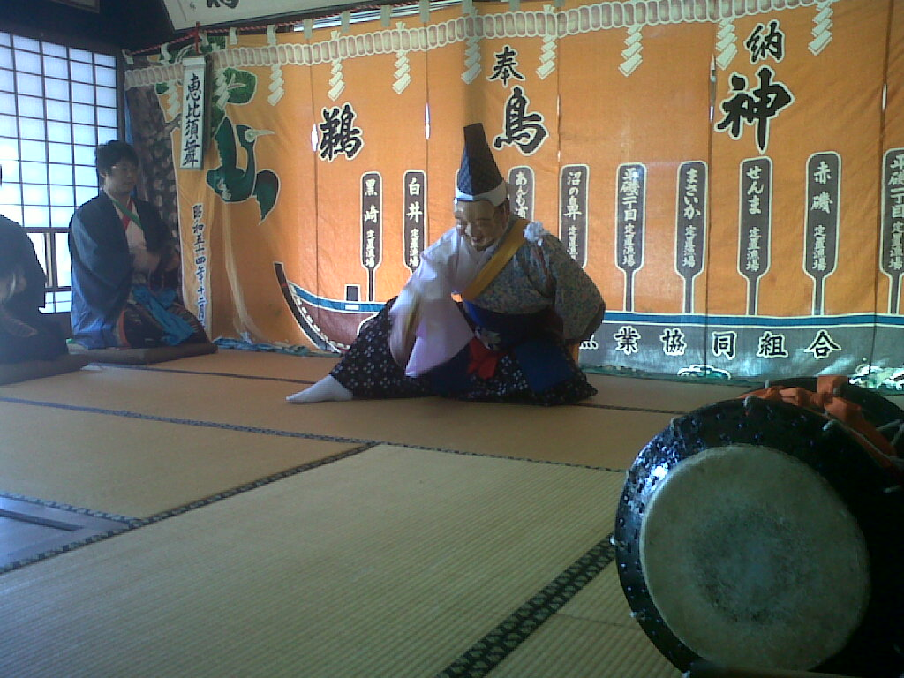
Thank You!

